Slide 1
Analyze data on list pages Usage scenarios
Public preview
Business Central
2023 release wave 1

Slide 2
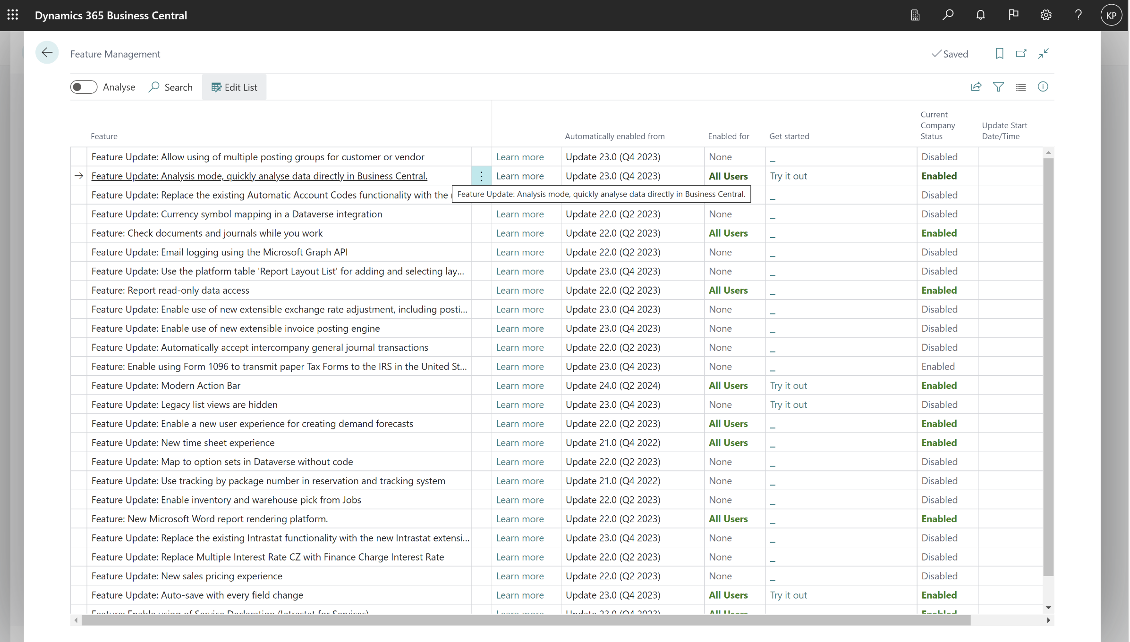
Enable under Feature Management

Slide 3
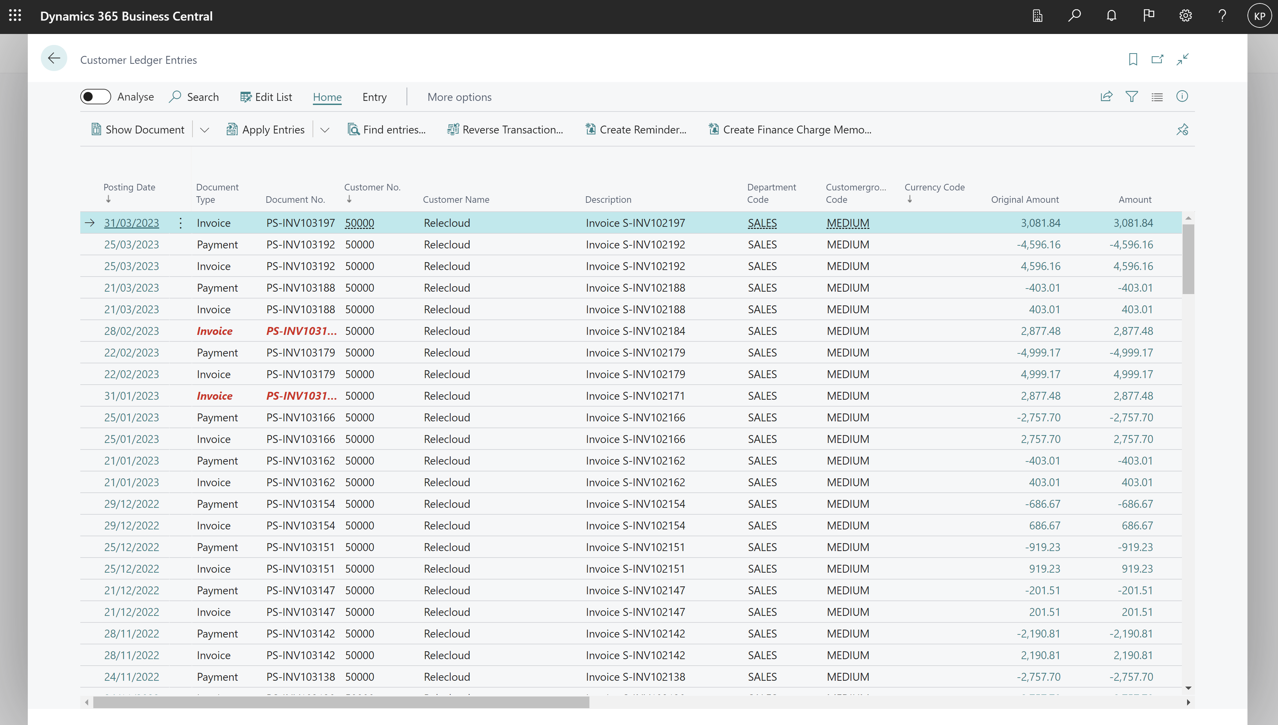
Go to Analysis Mode on a list page

Slide 4
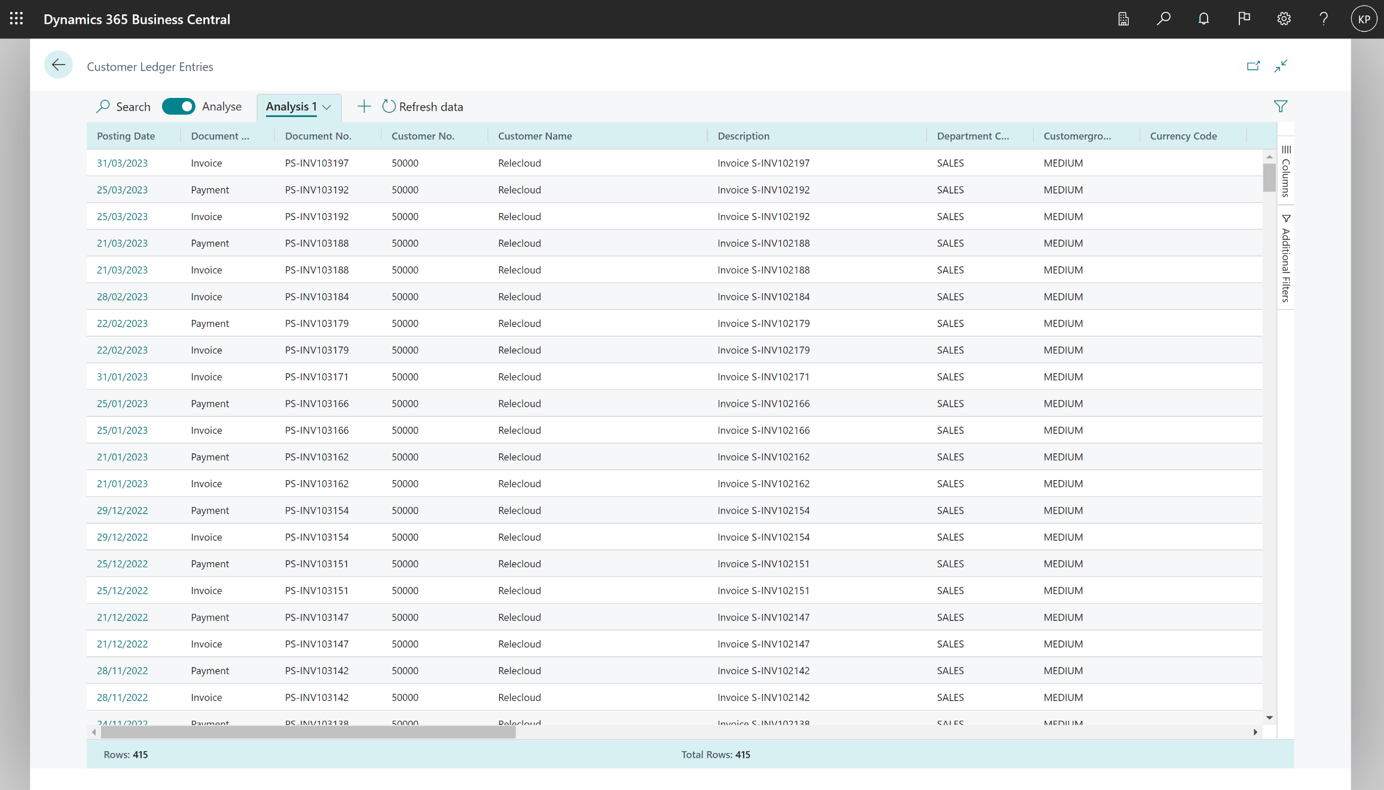
Opens the list with additional analysis capabilities

Slide 5
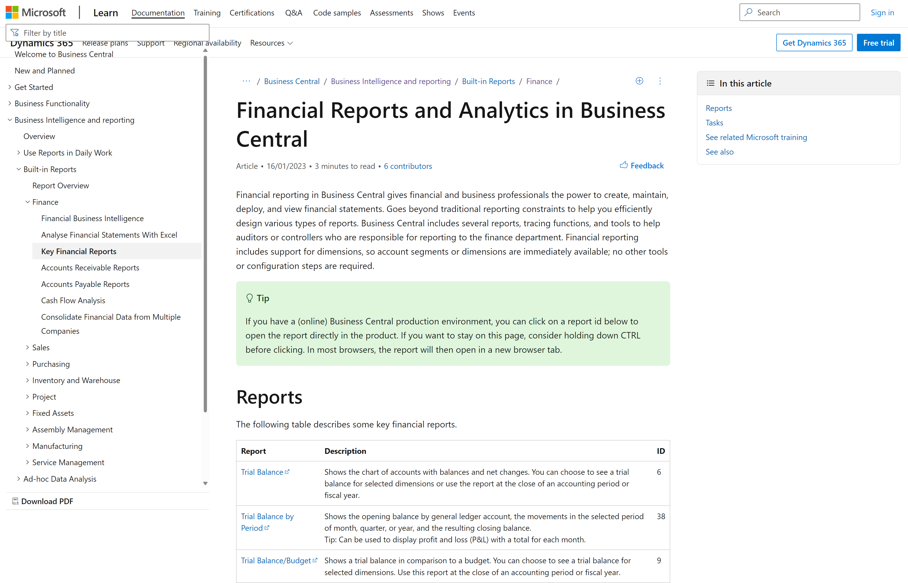
https://aka.ms/bcreporting

Slide 6
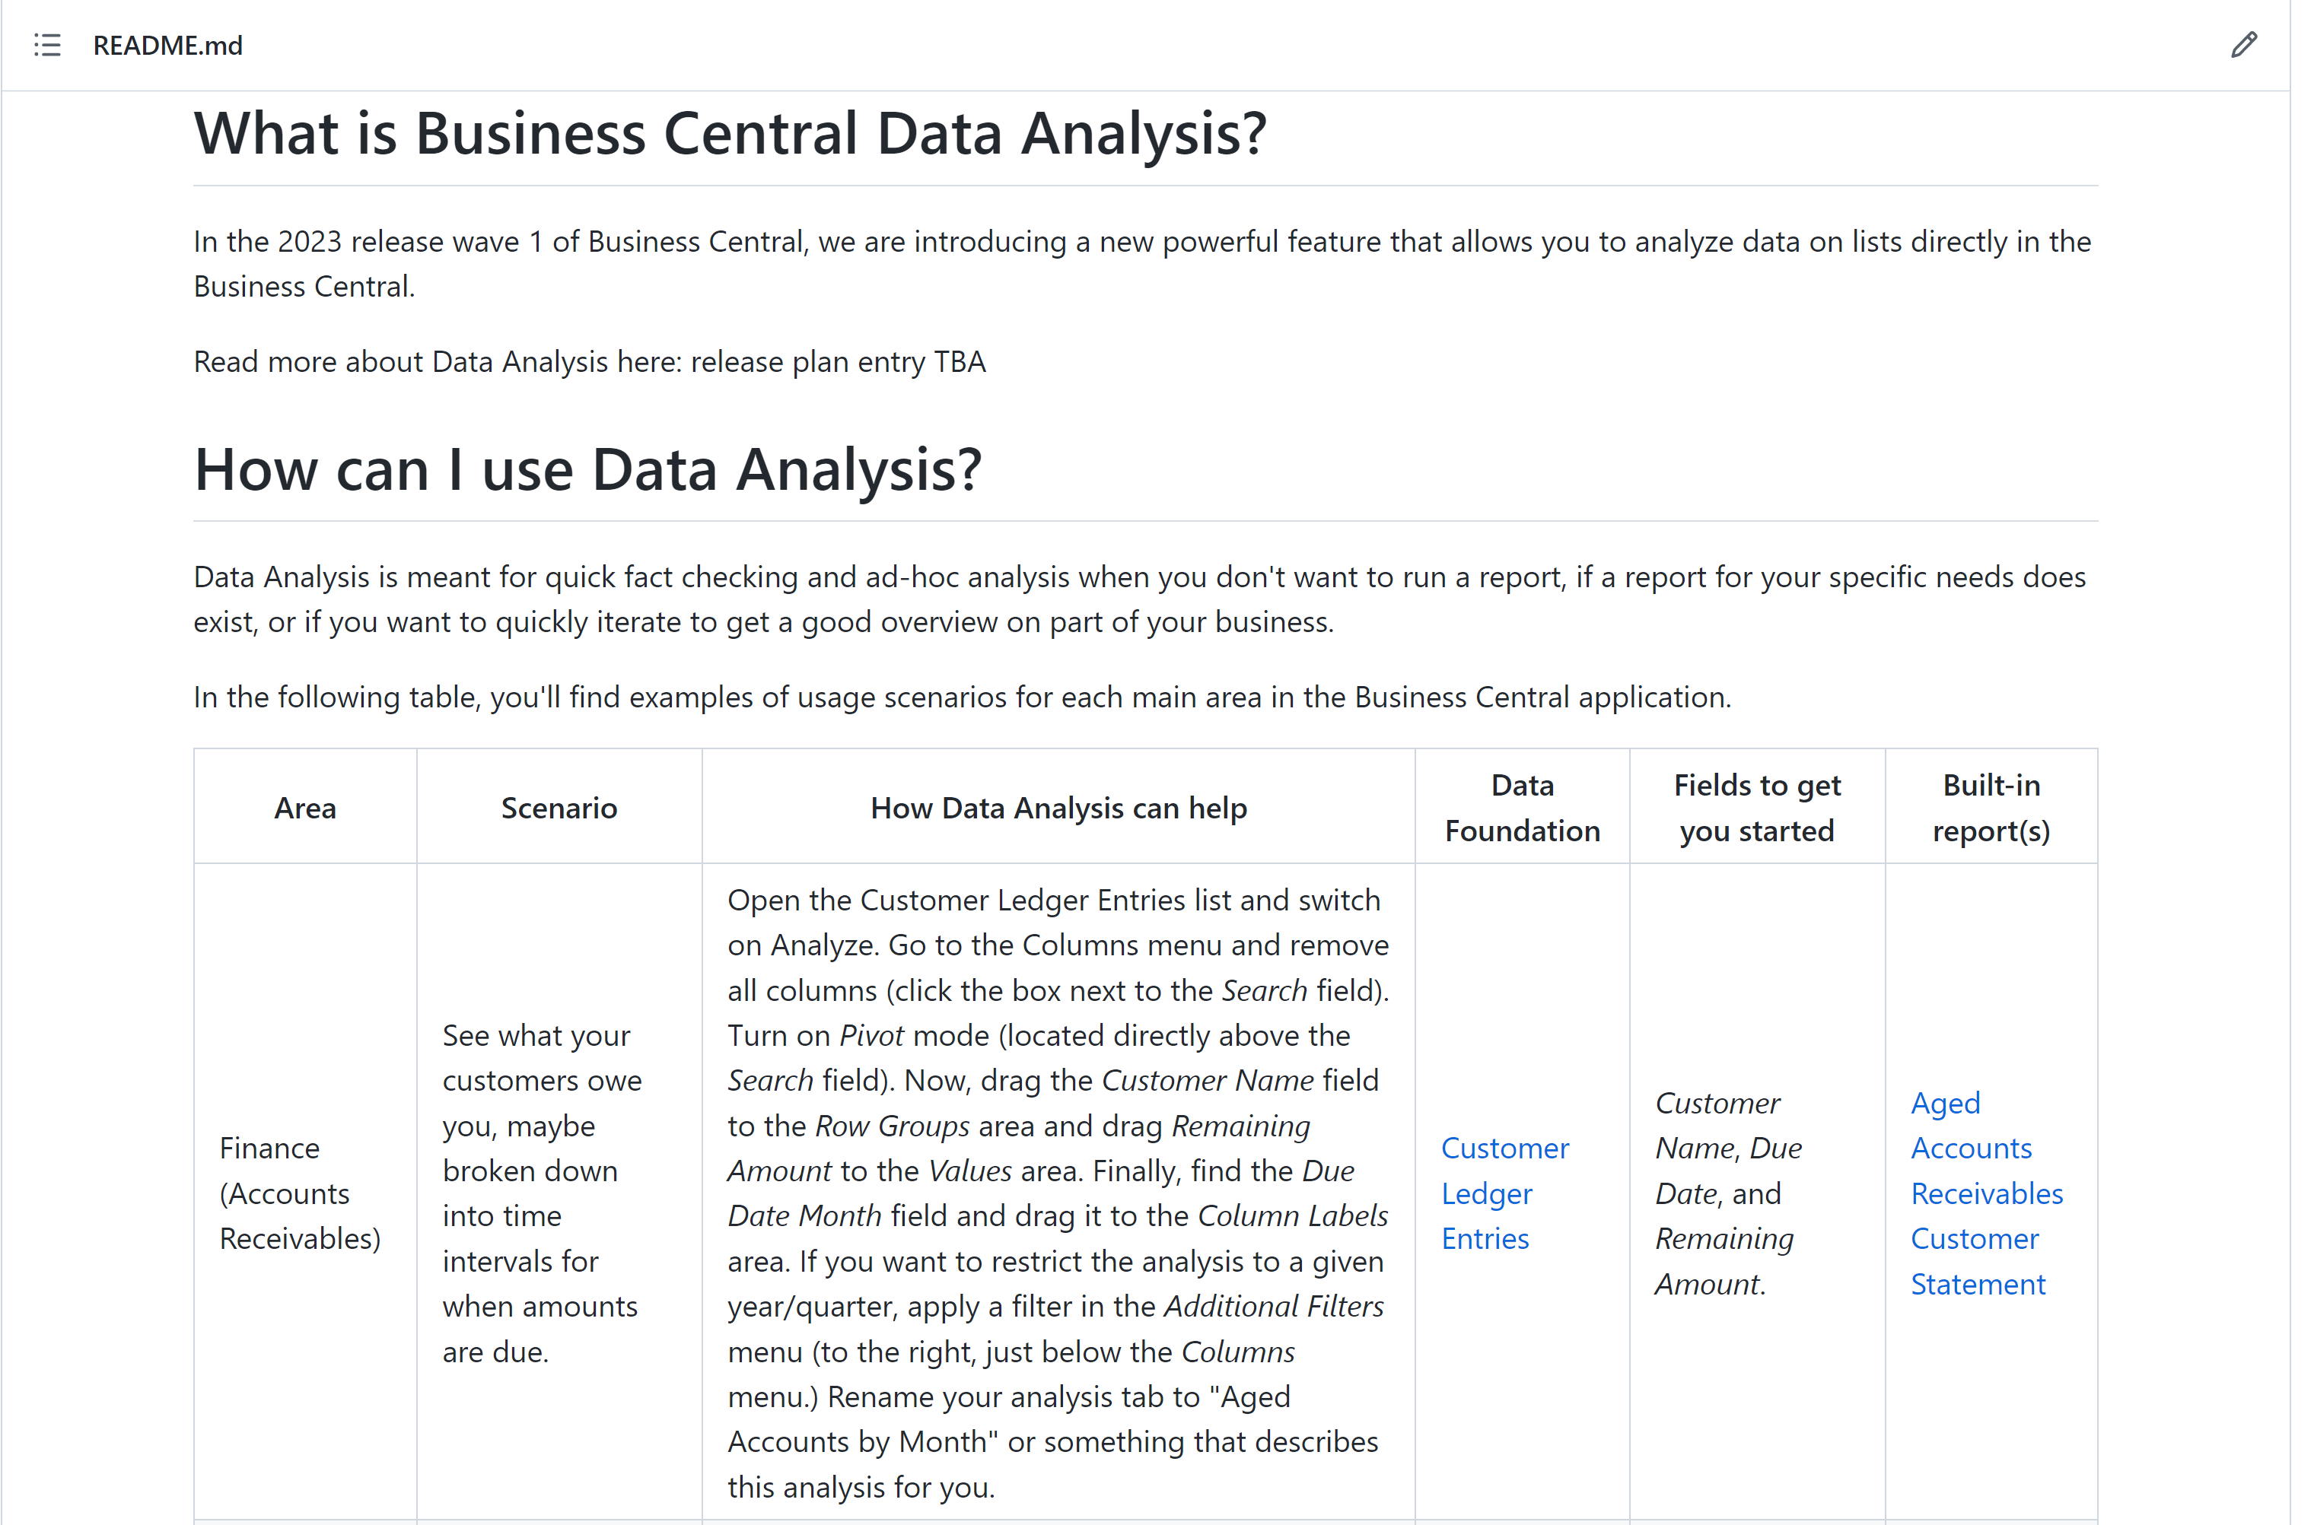
https://aka.ms/bcdataanalysis

Slide 7
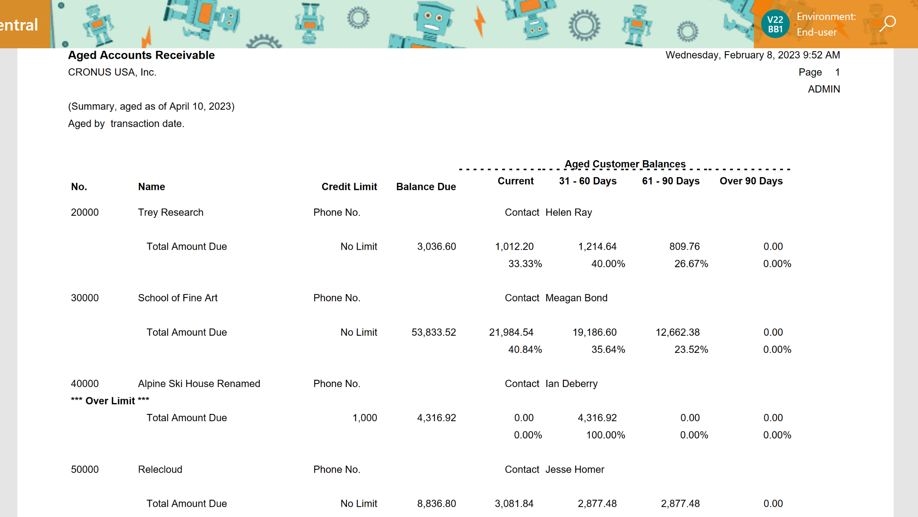
Before: run a report, get a pdf

Slide 8
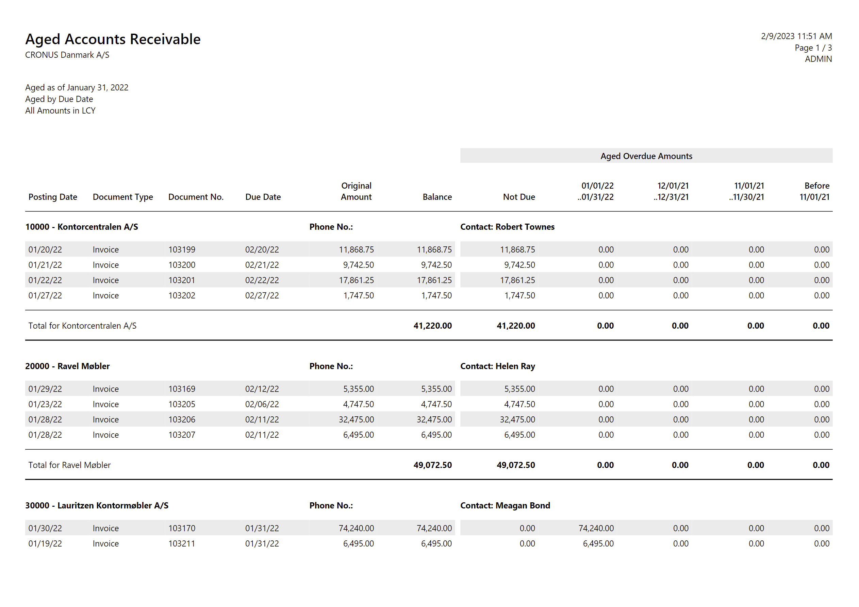
Before: run a report, get a pdf
W1 version ;o)

Slide 9
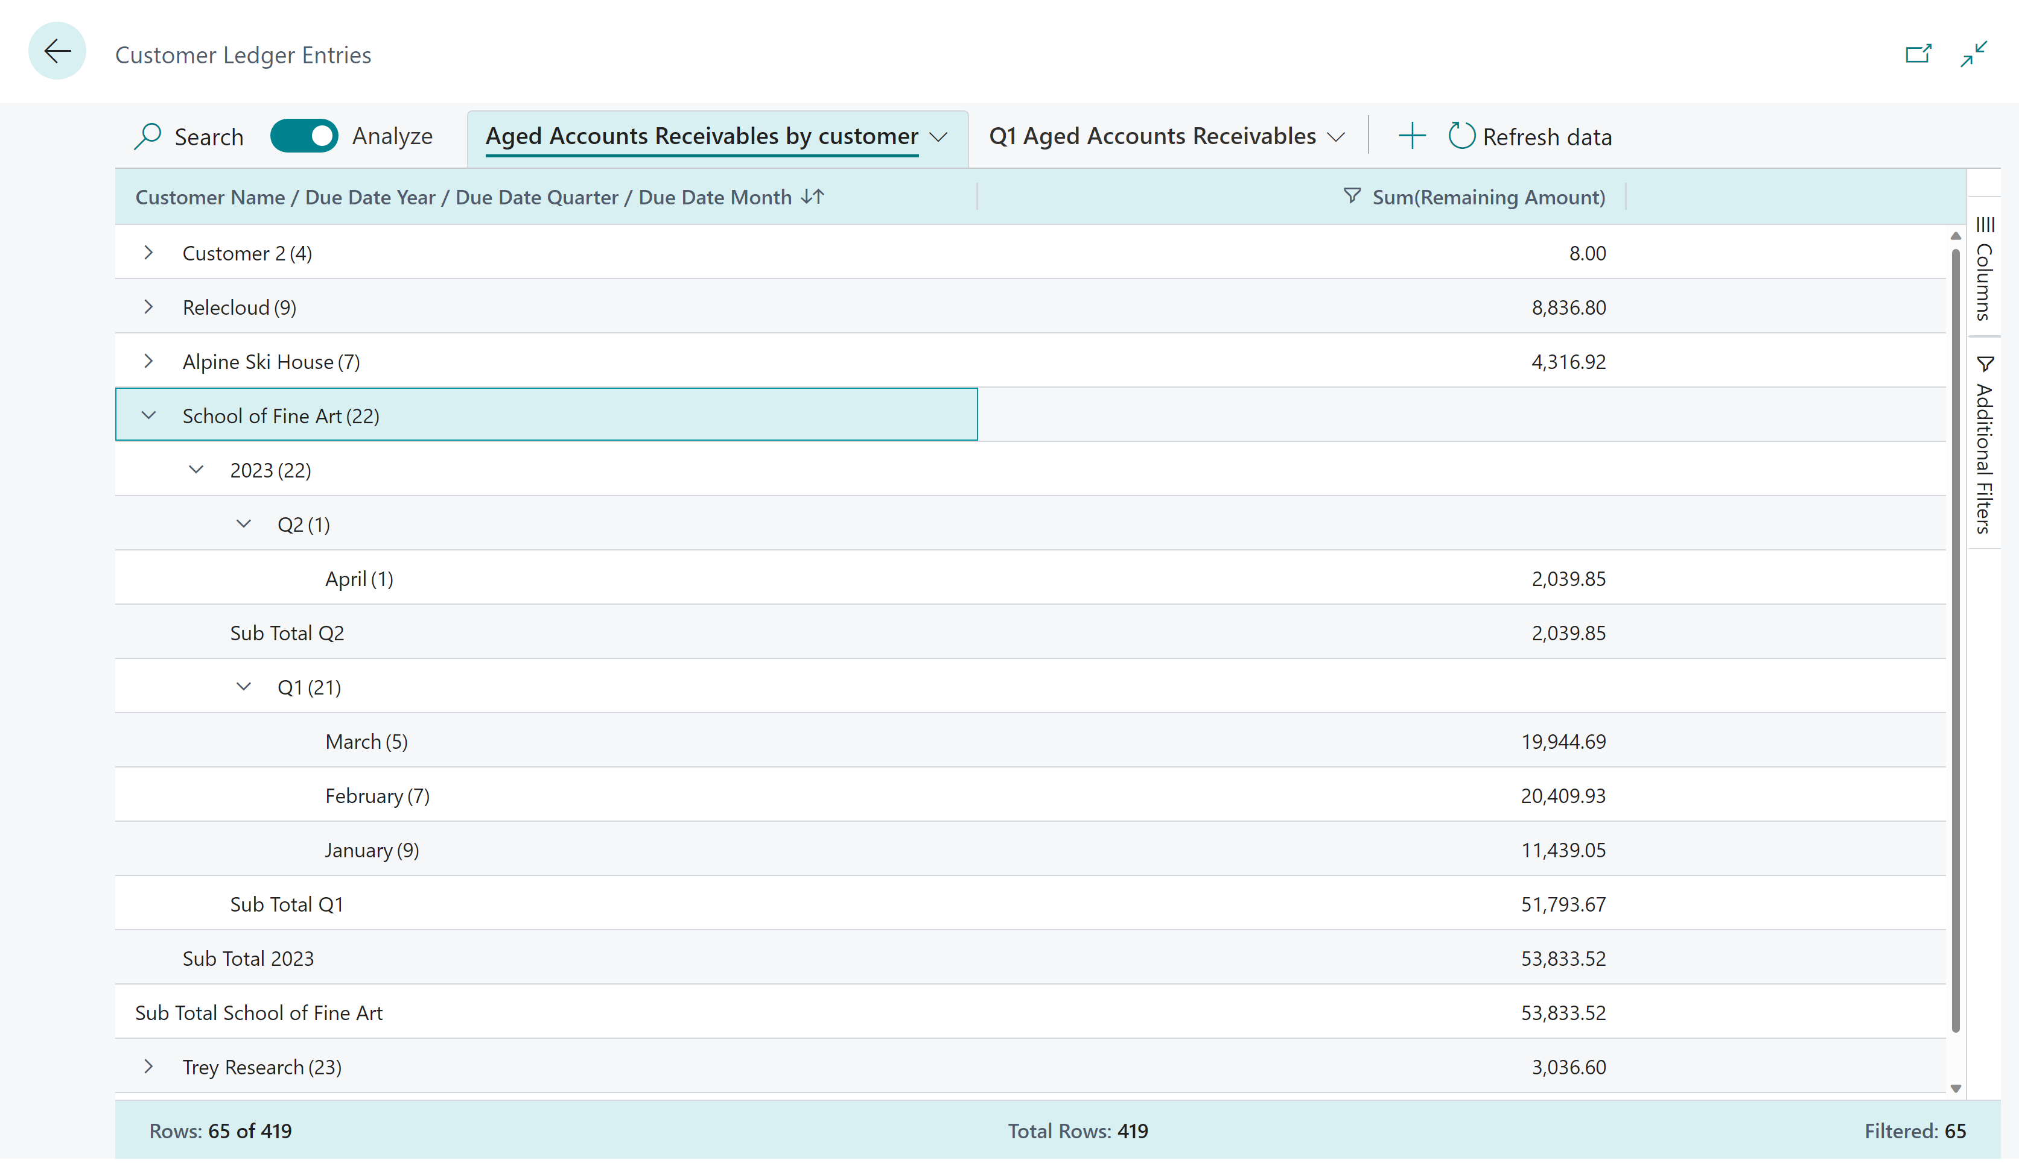
Now: self-service with Analysis Mode

Slide 10
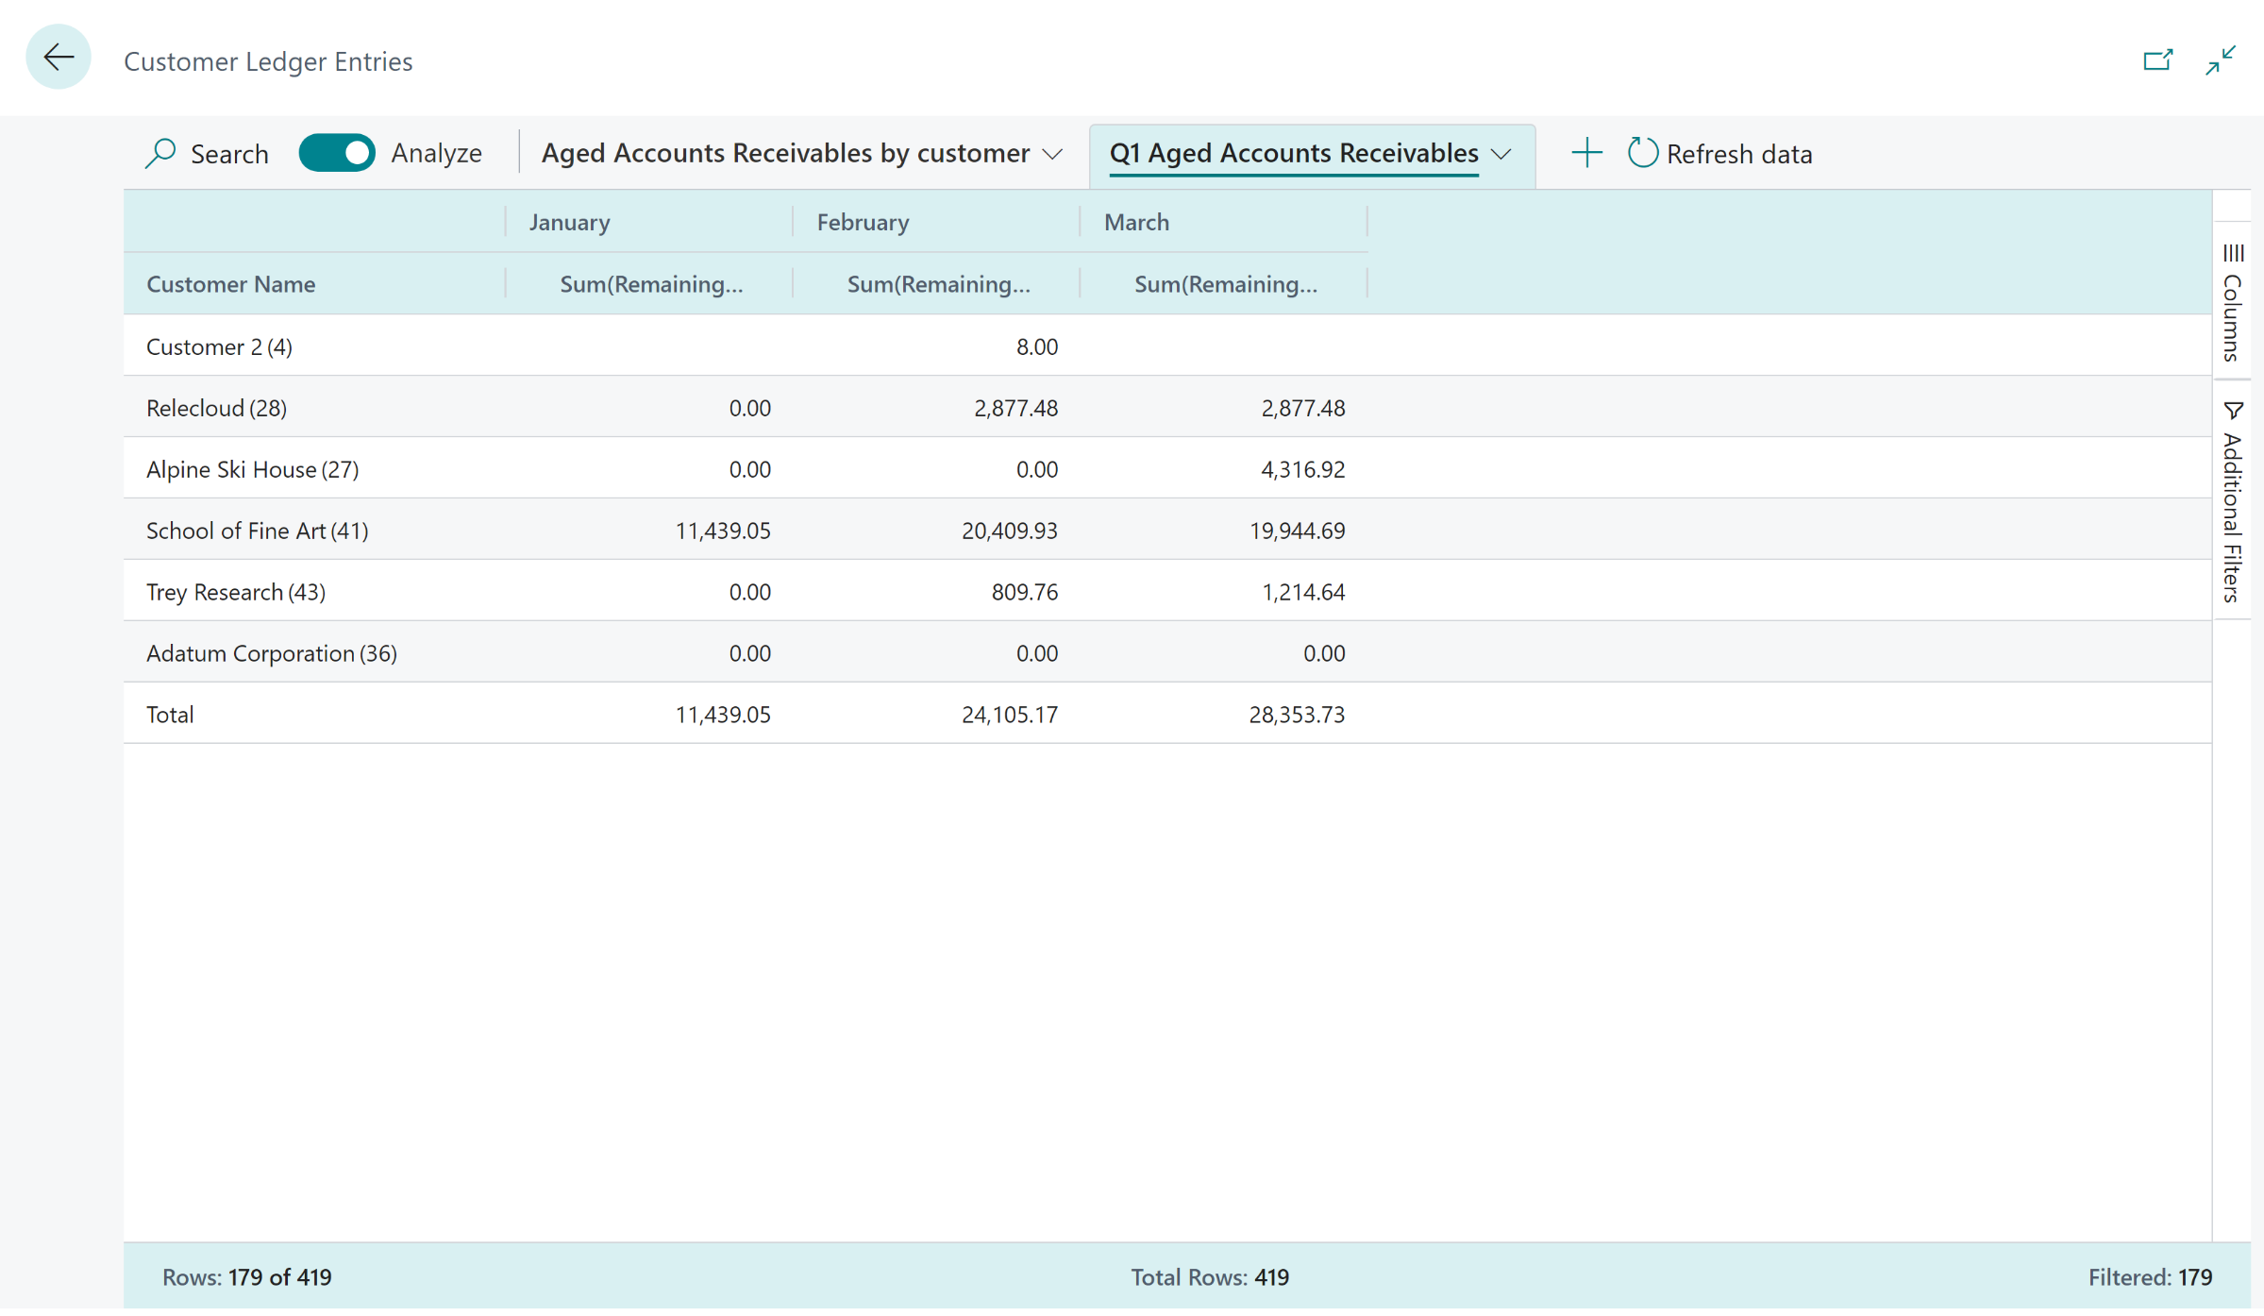
Now: self-service with Analysis Mode

Slide 11
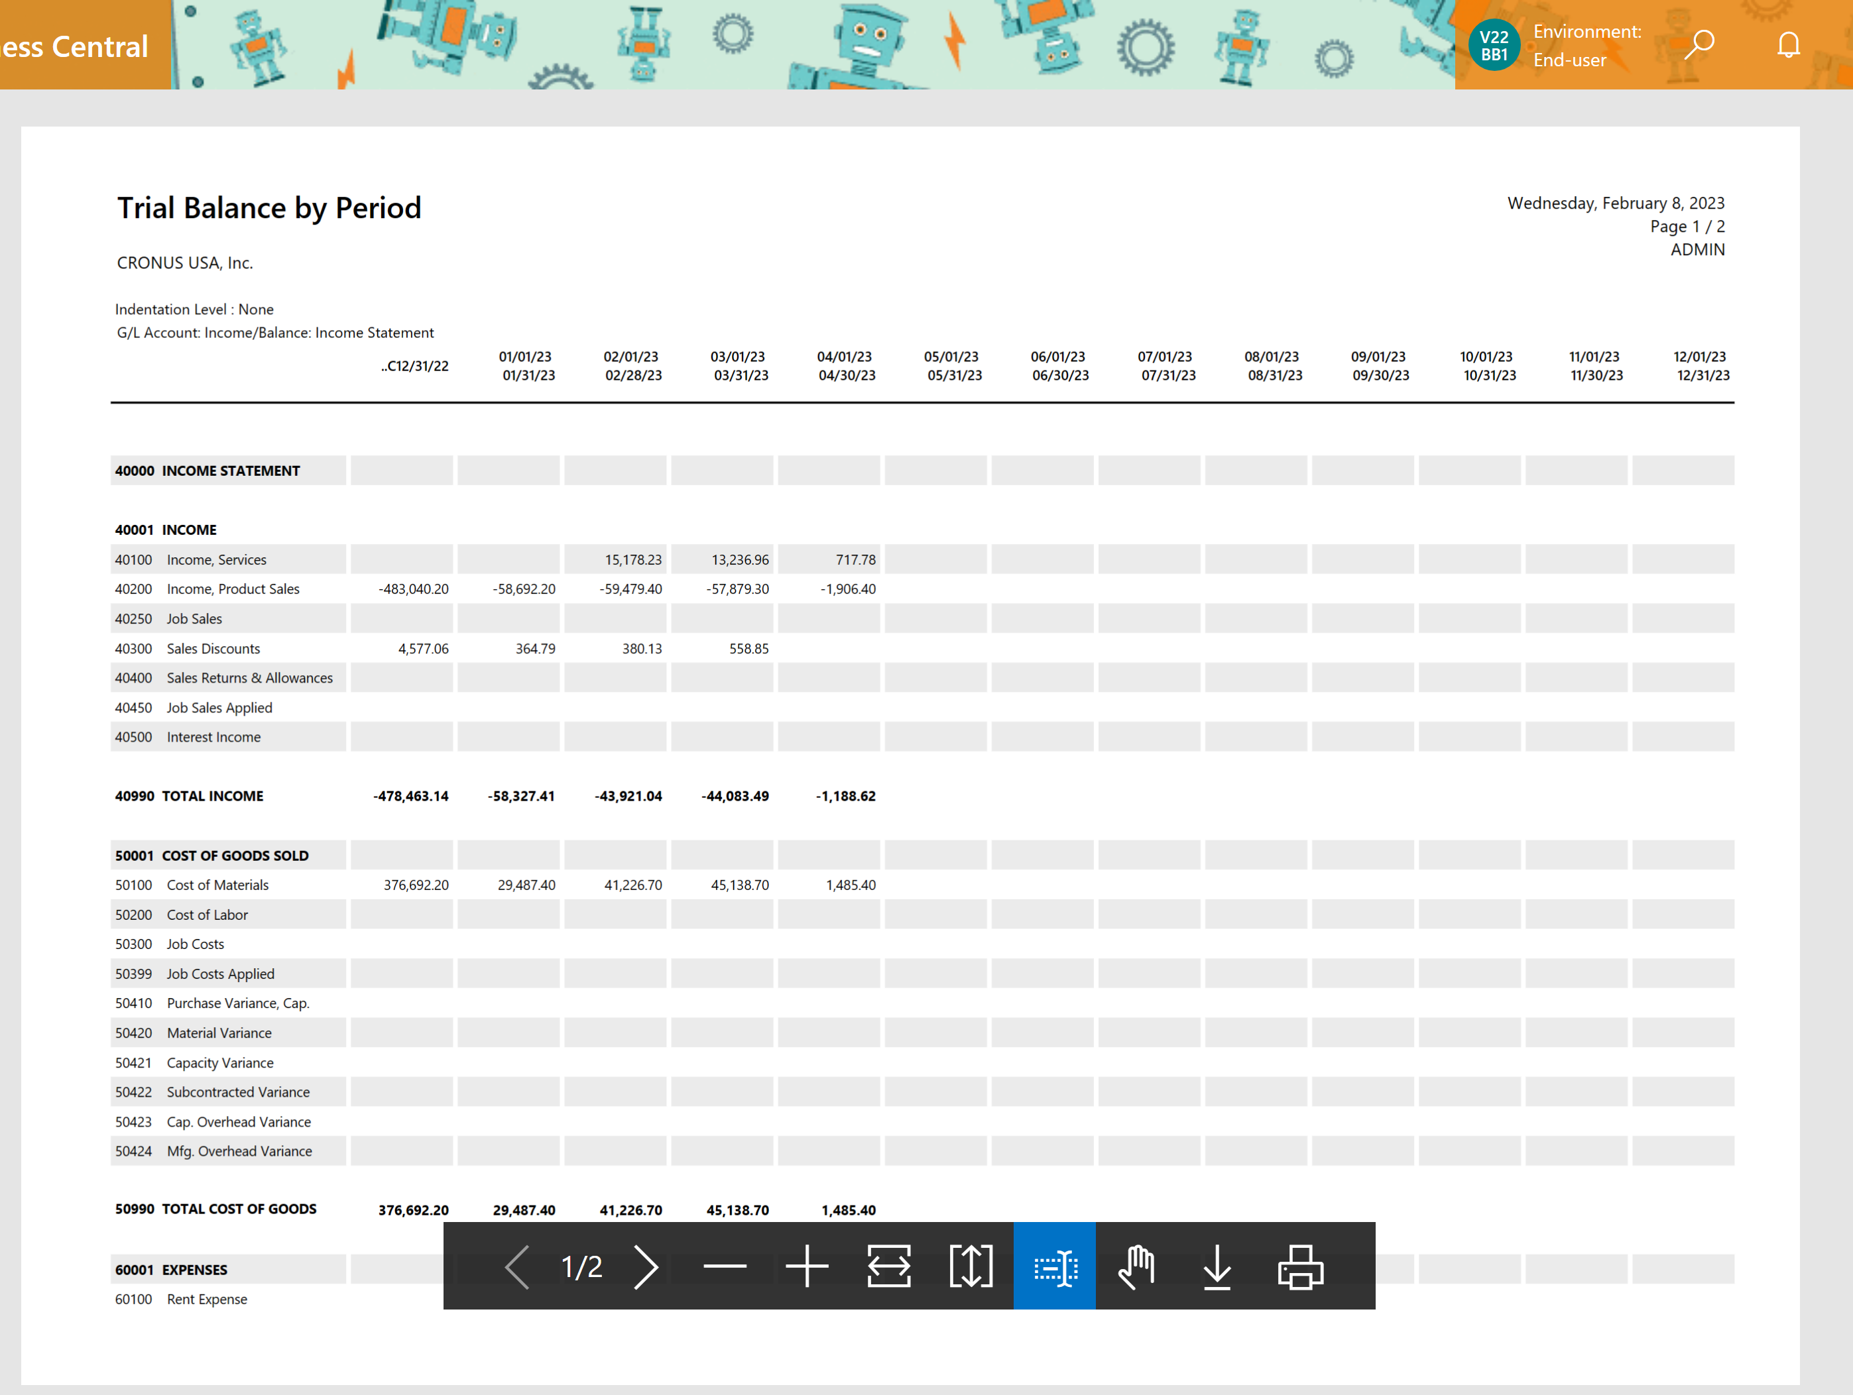
Before: Income statement as a pdf

Slide 12
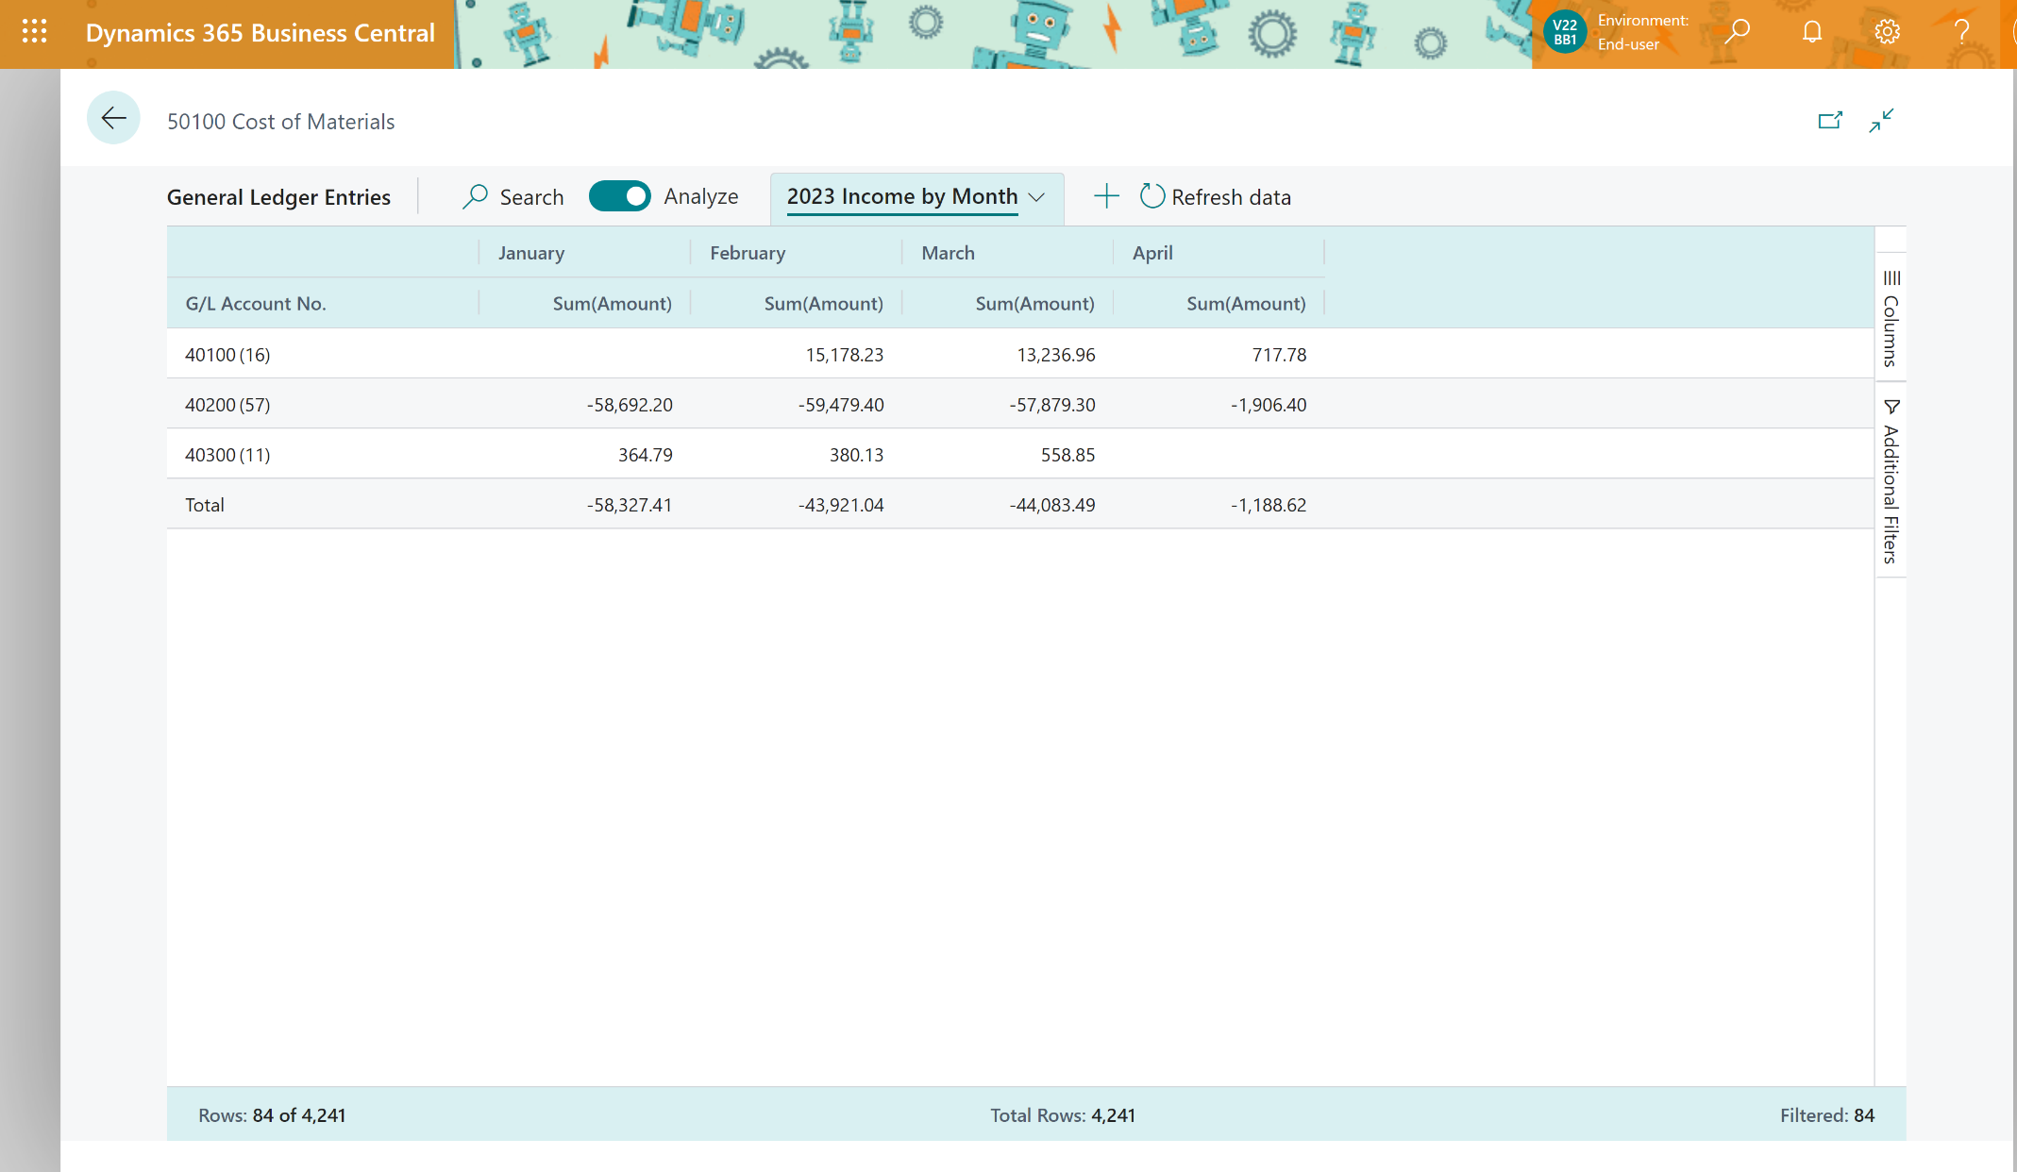
Now: Click-clickety-click income statement with Analysis mode

Slide 13
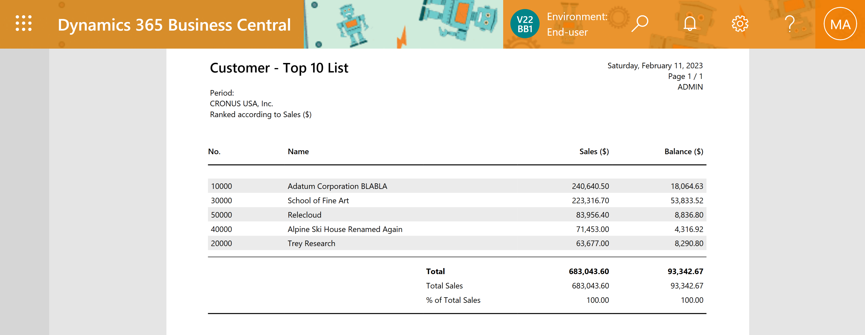
Customer top 10 list

Slide 14
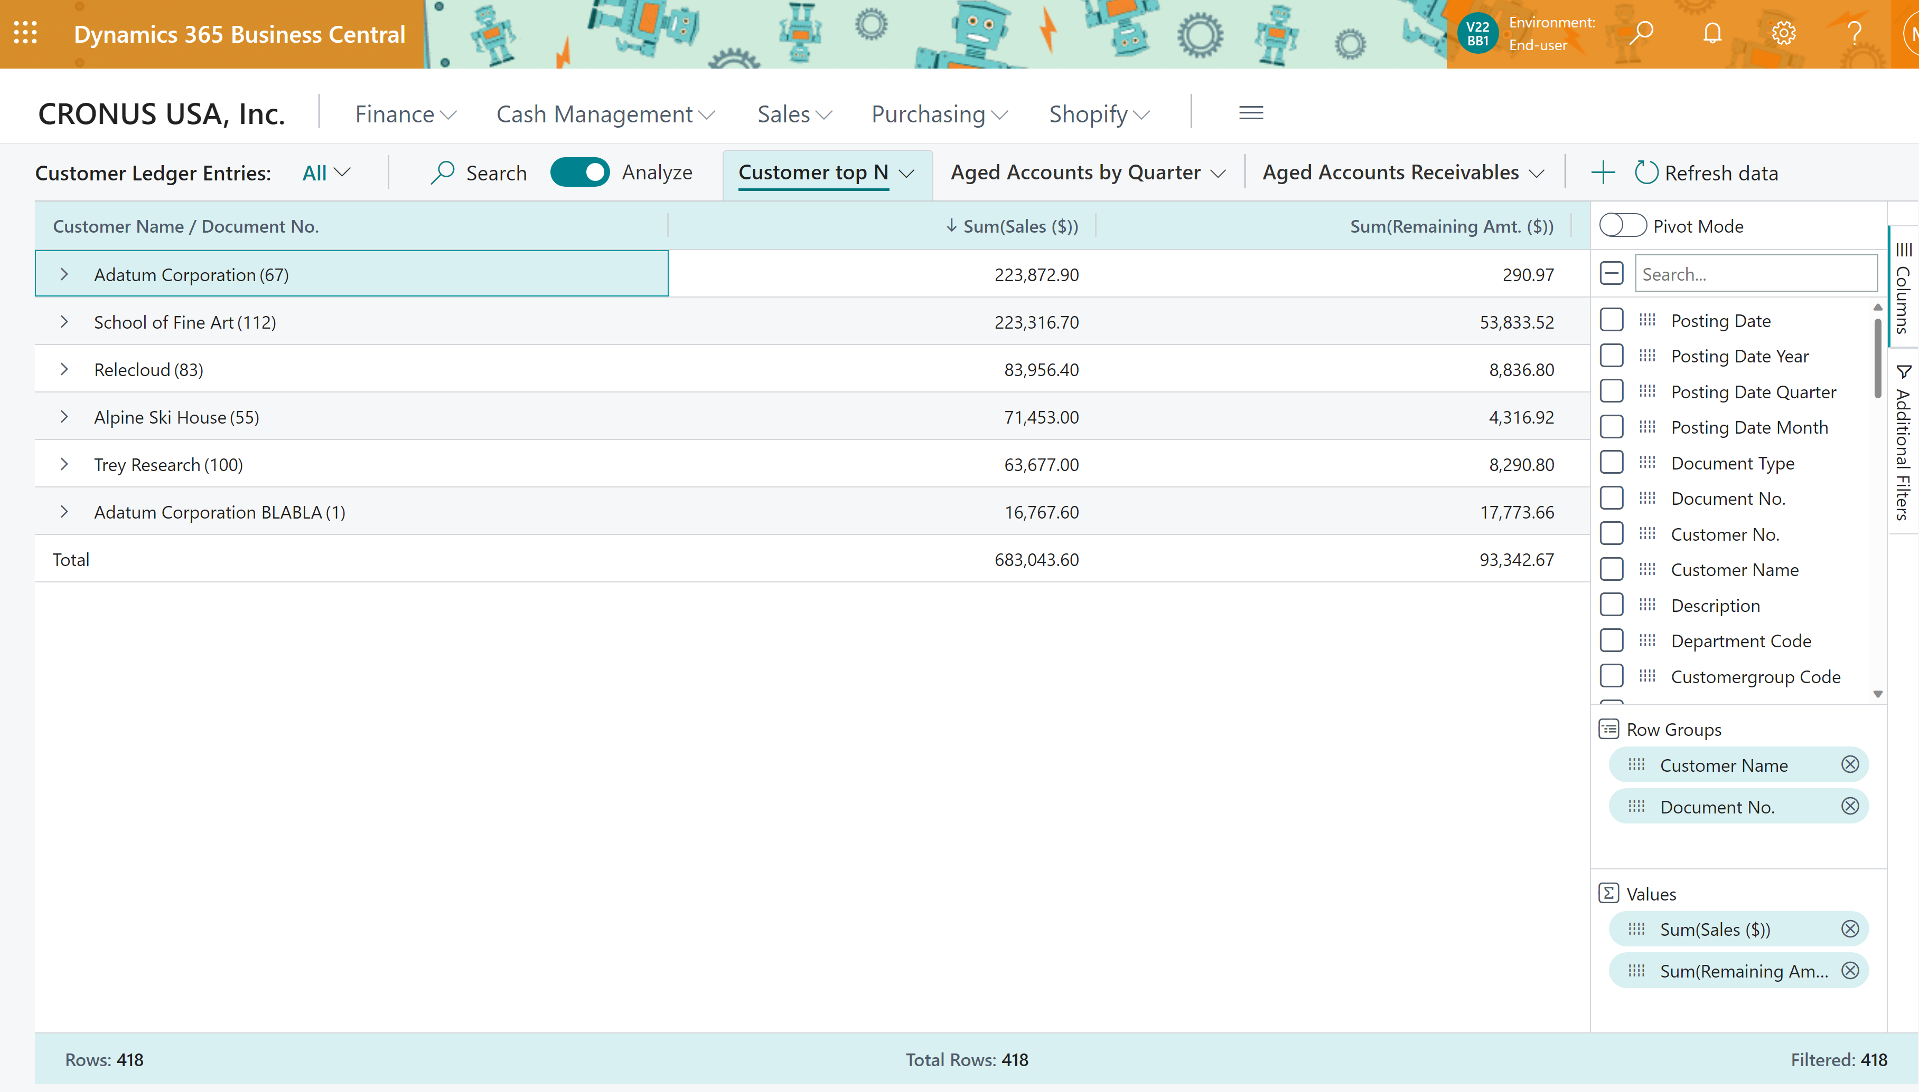
DIY Customer top N

Slide 15
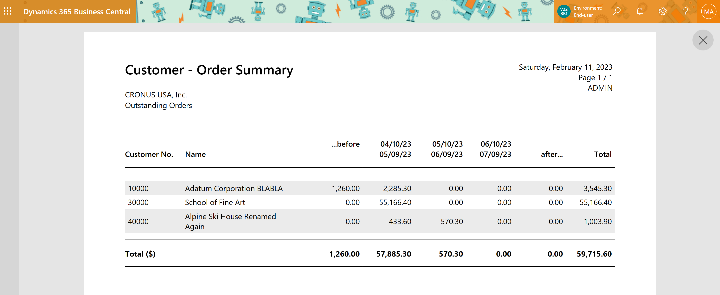
Customer - Order Summary

Slide 16
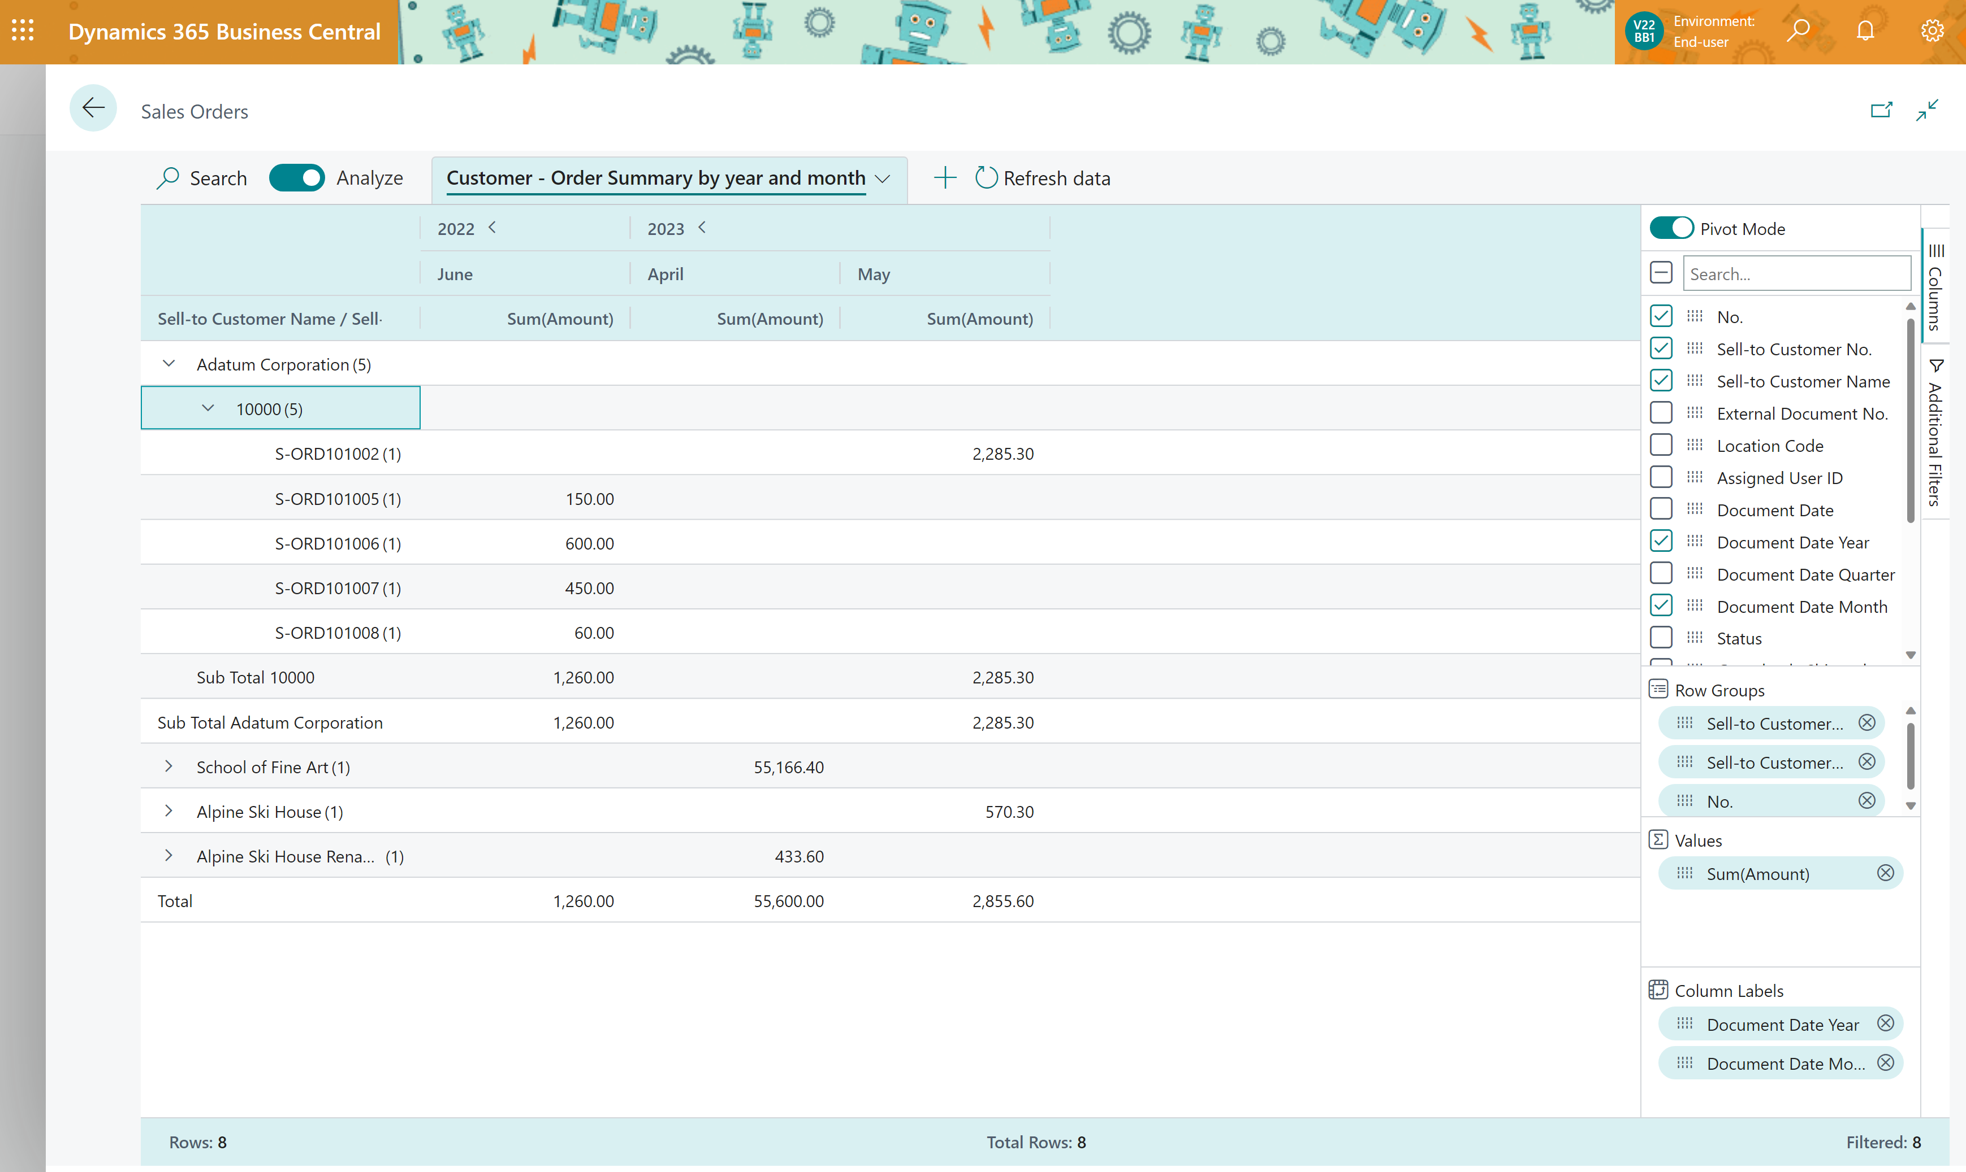
DIY Customer - Order Summary

Slide 17
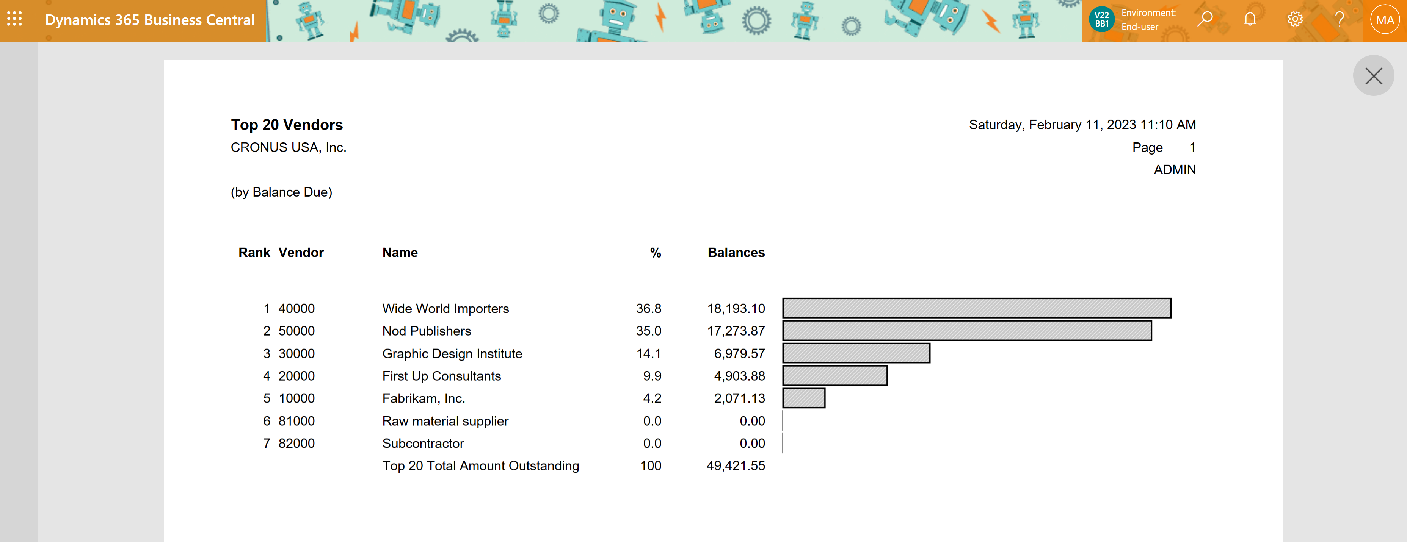
Top N vendors (by balance)

Slide 18
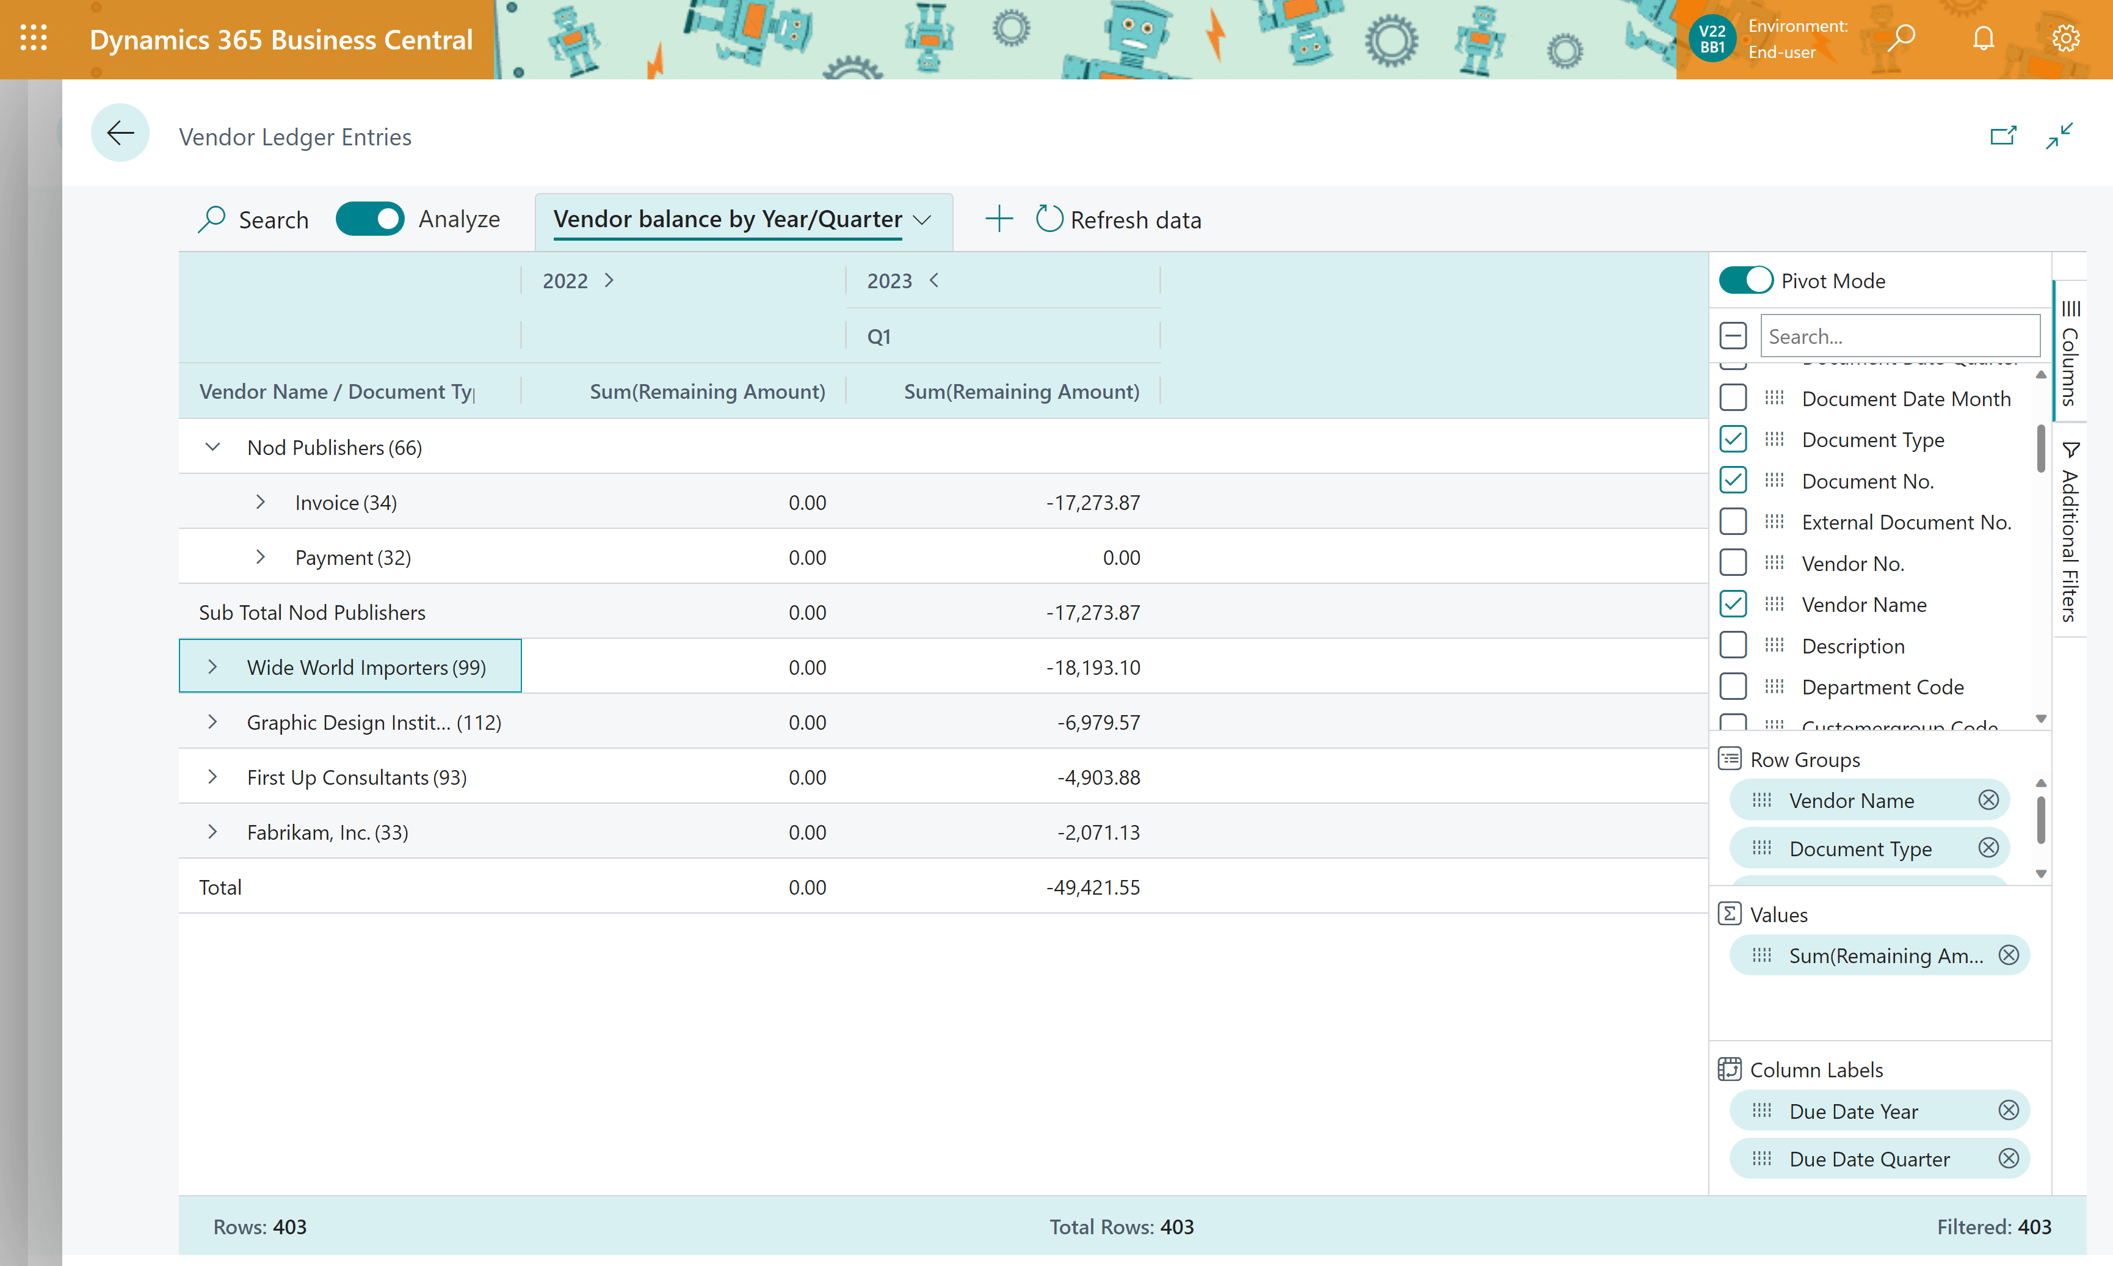
DIY Top N vendors (by balance)

Slide 19
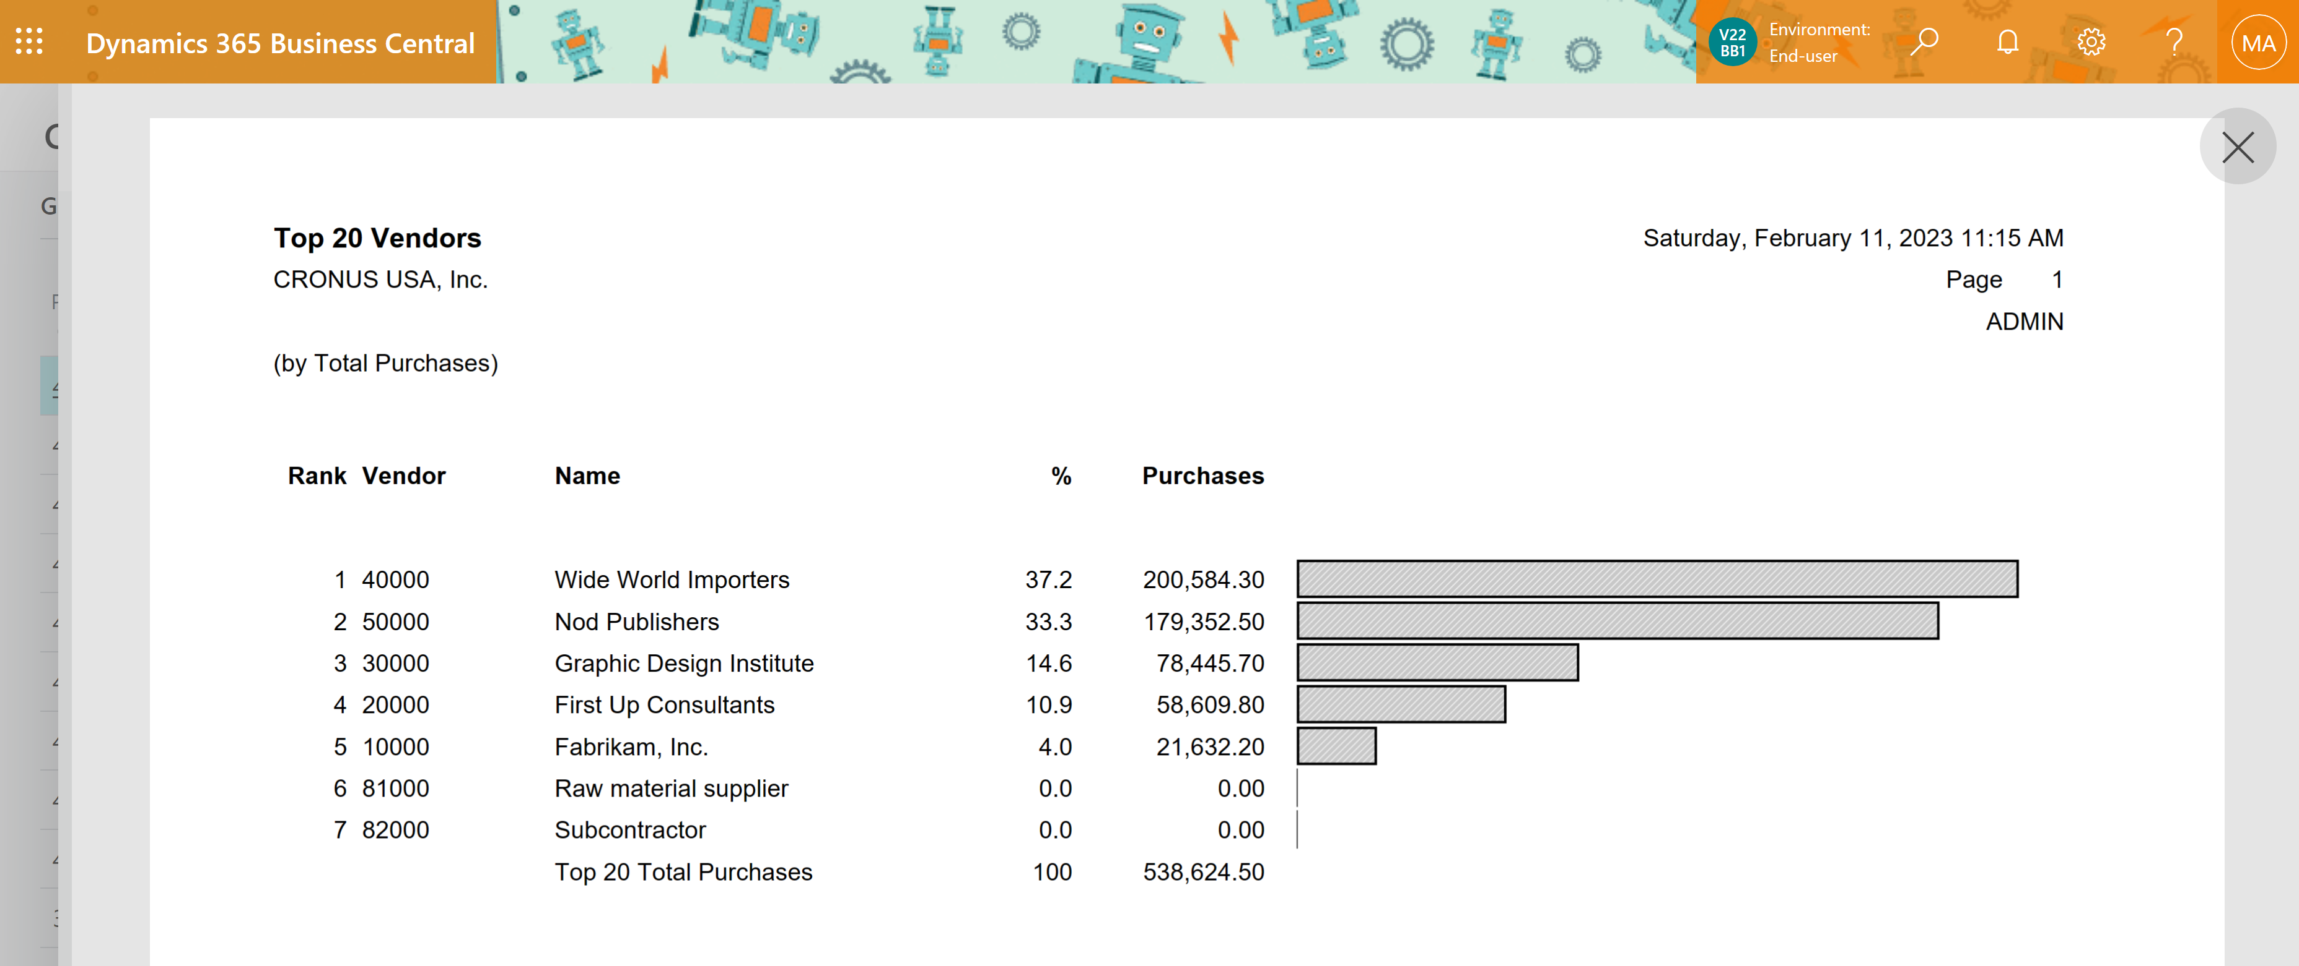
Top N vendors (by purchase)

Slide 20
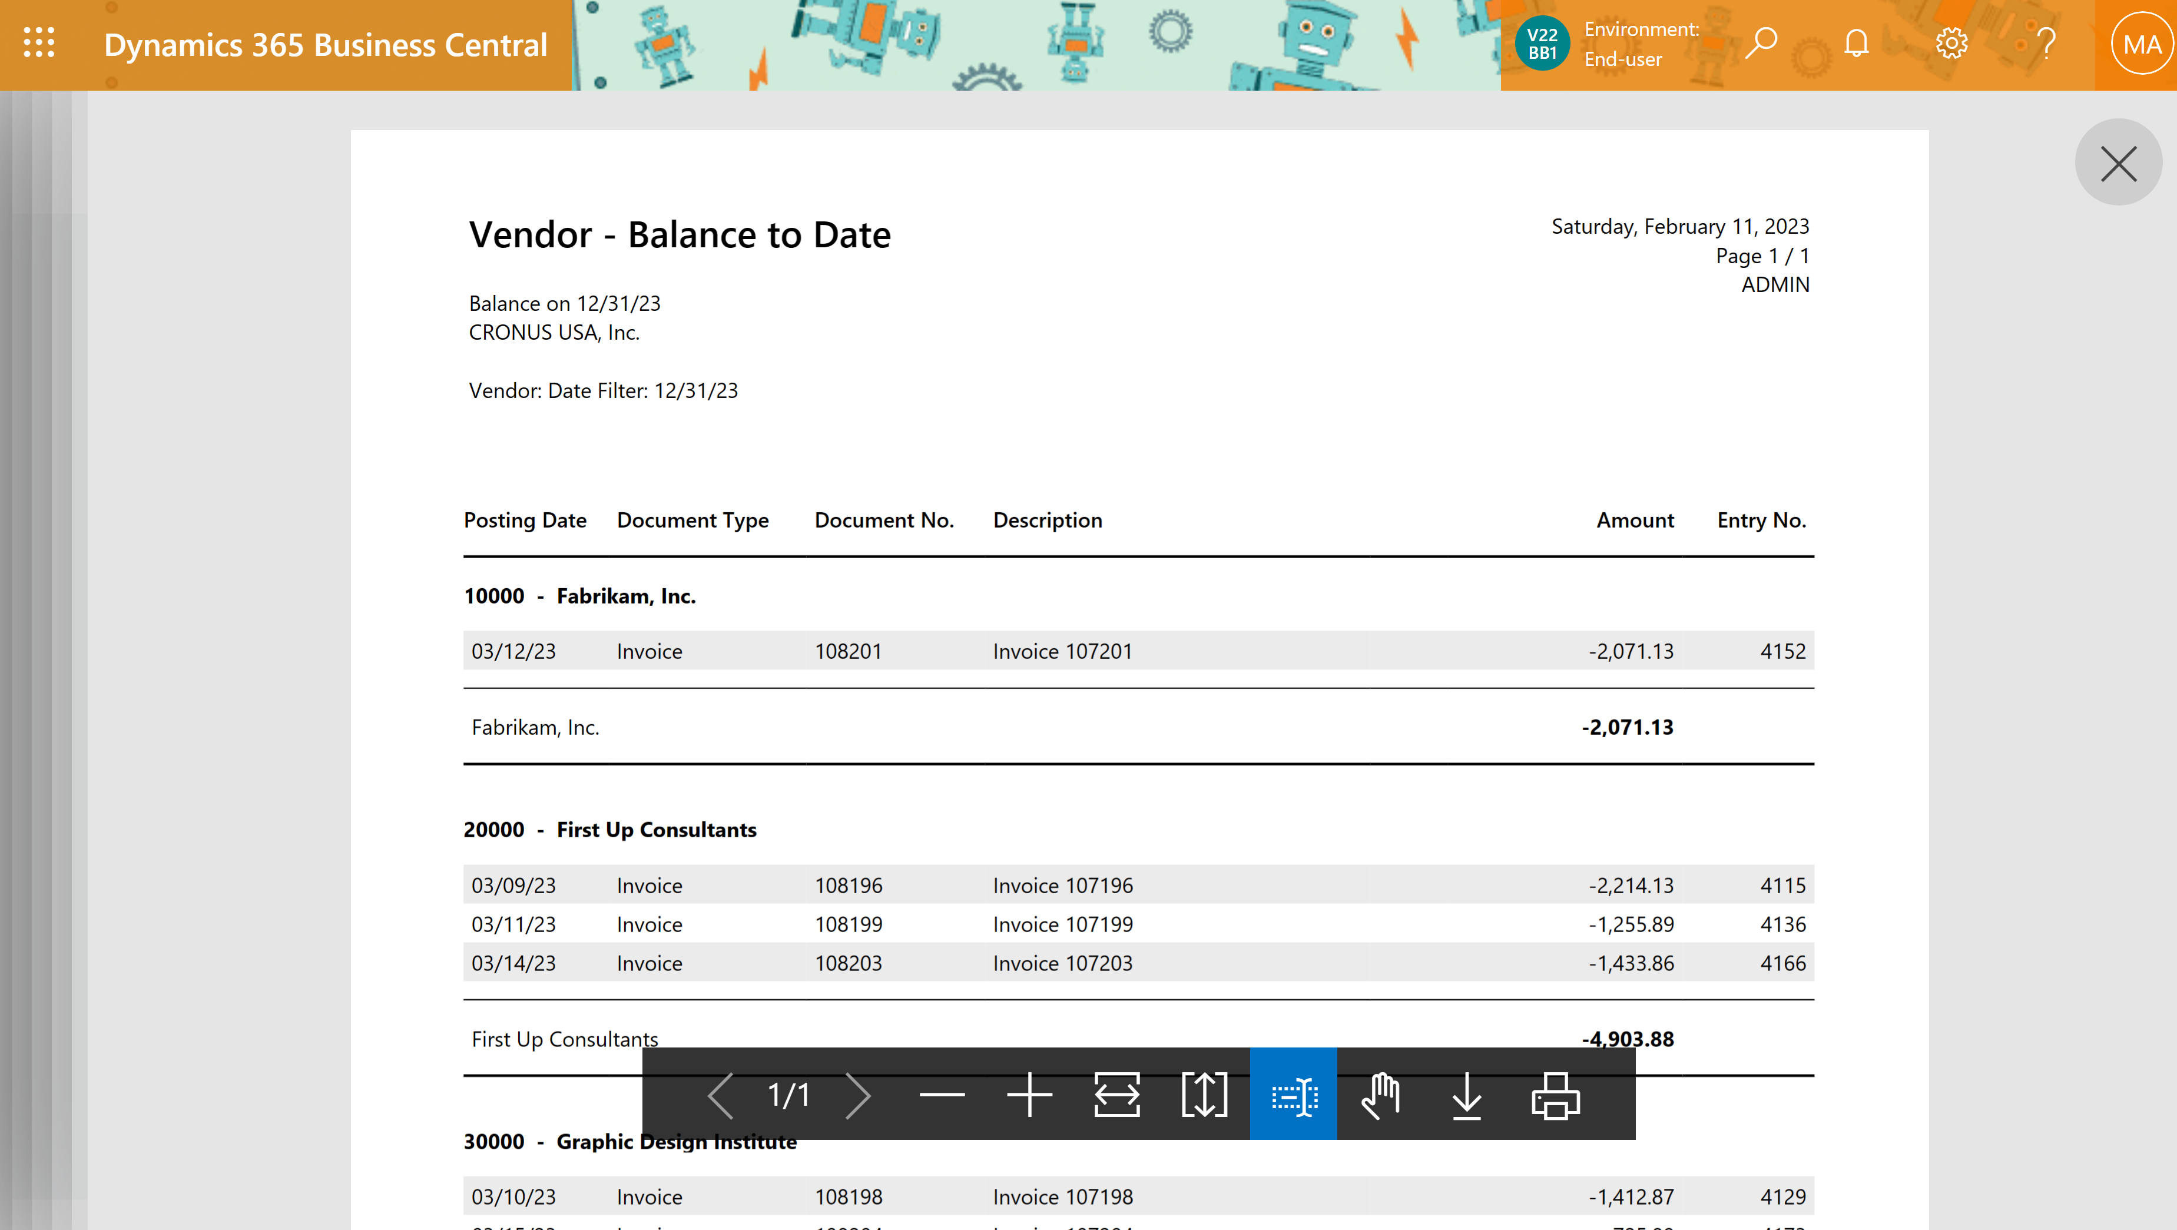
Vendor - Balance to Date

Slide 21
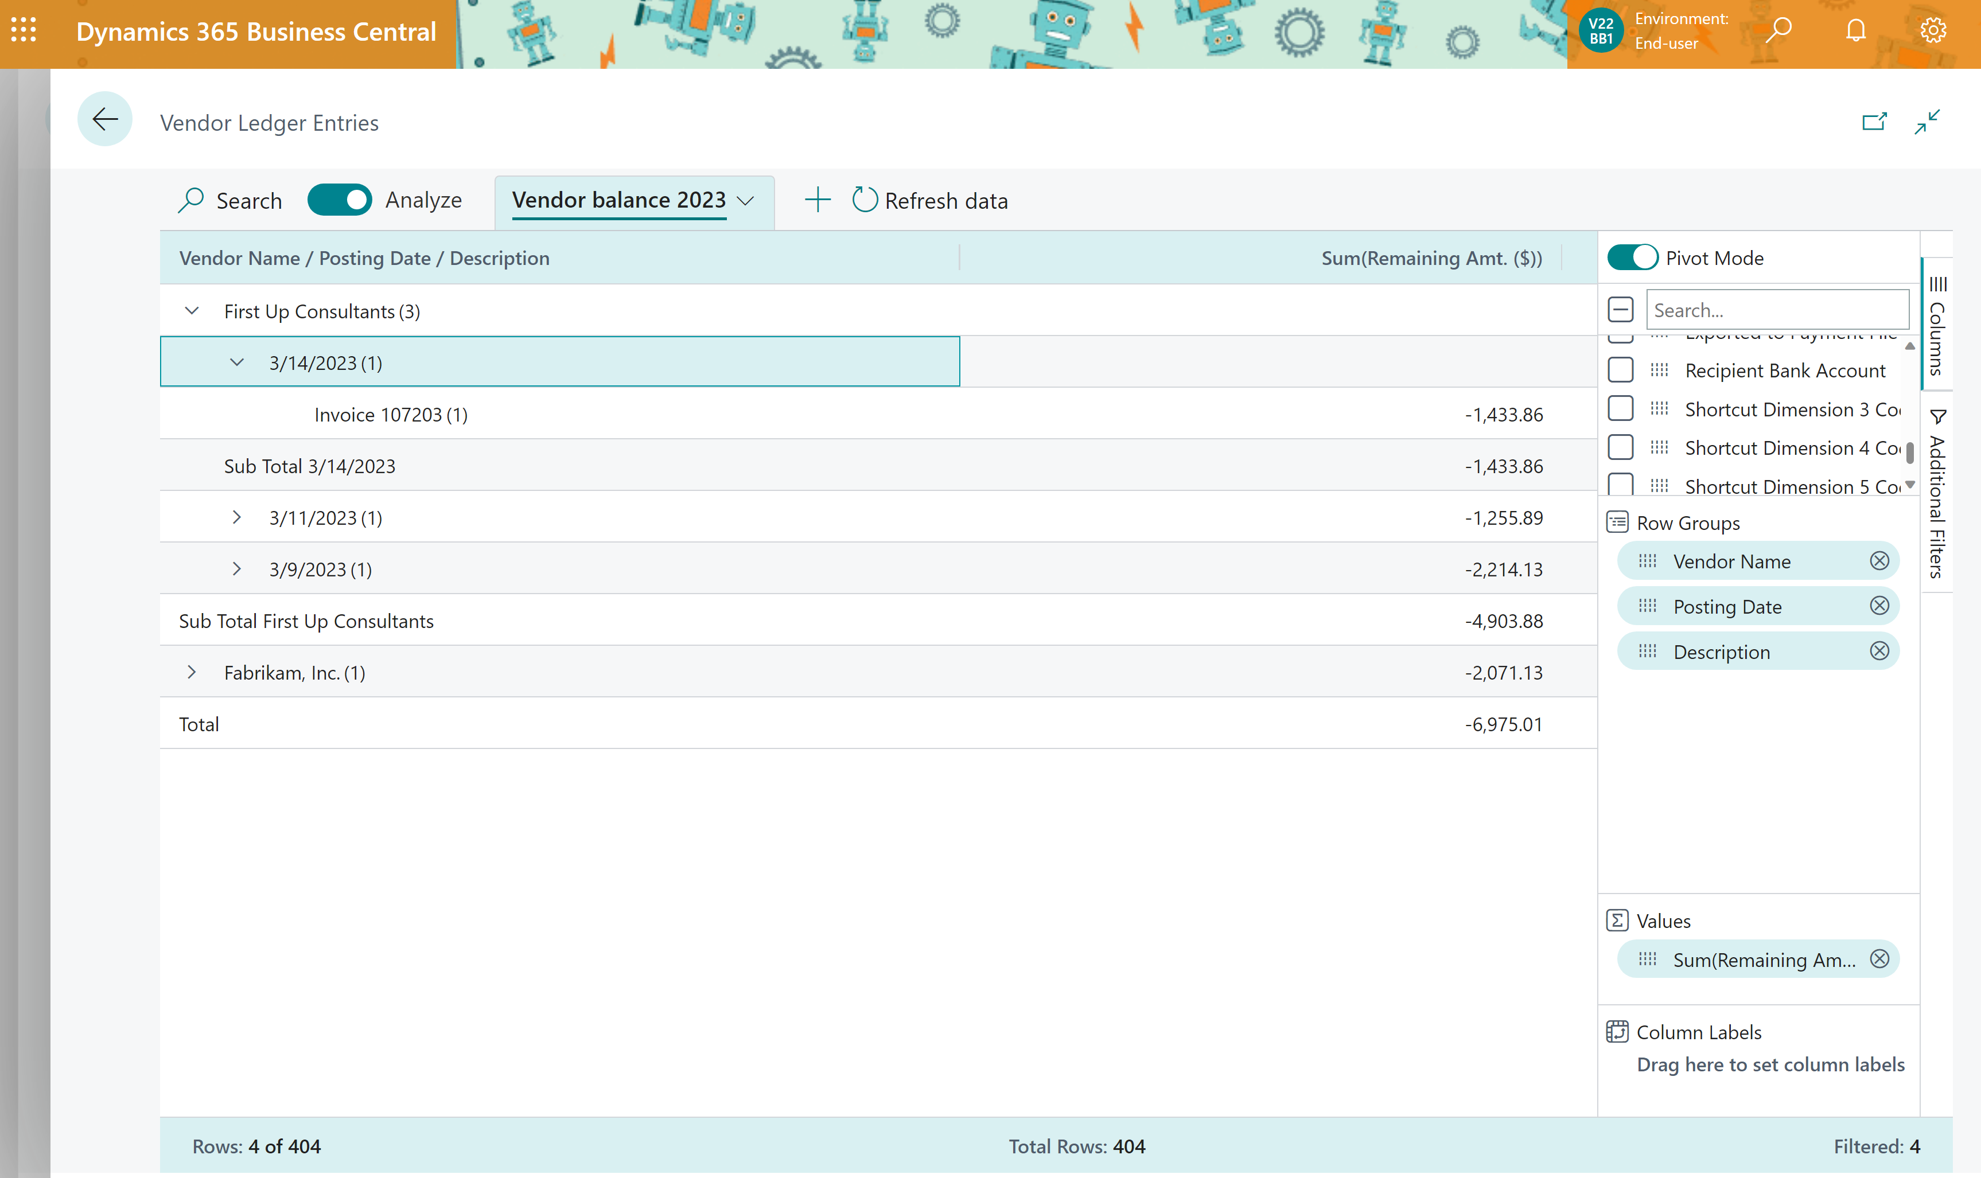
DIY Vendor - Balance to Date

Slide 22
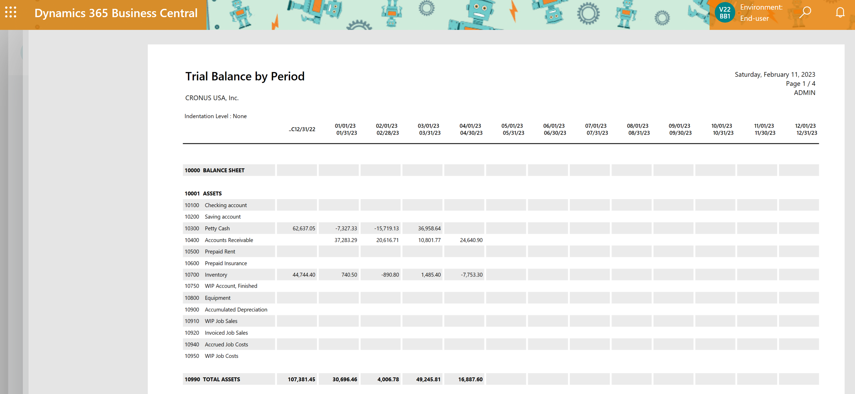
Total Assets report

Slide 23
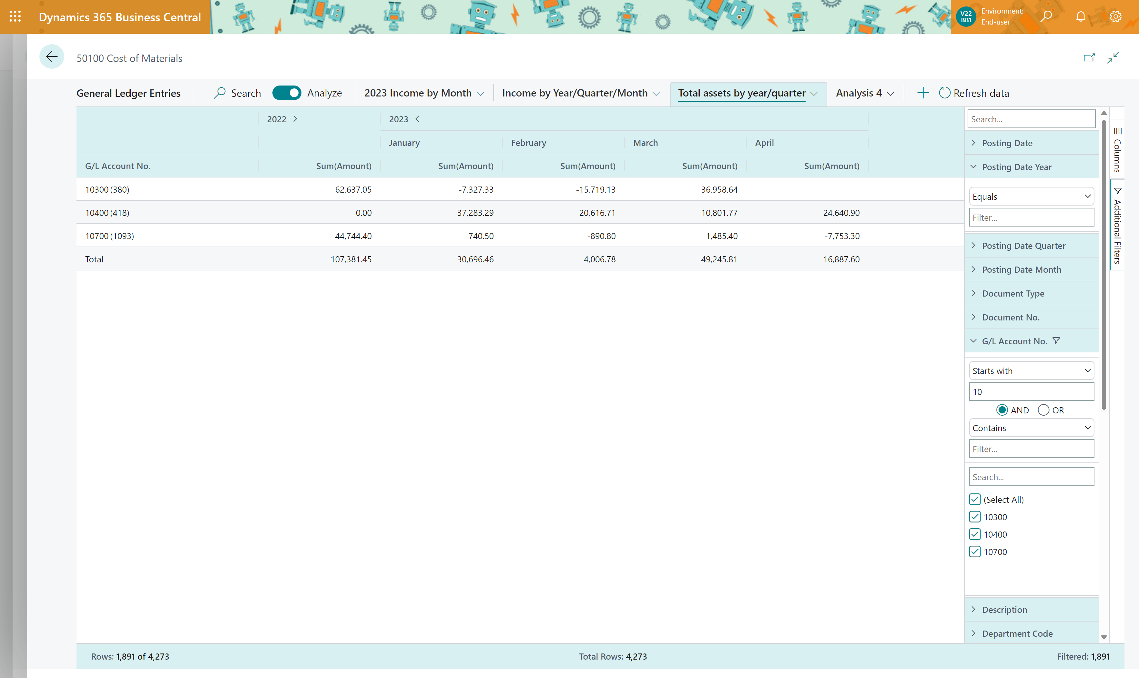
DYI Total Assets report

Slide 24
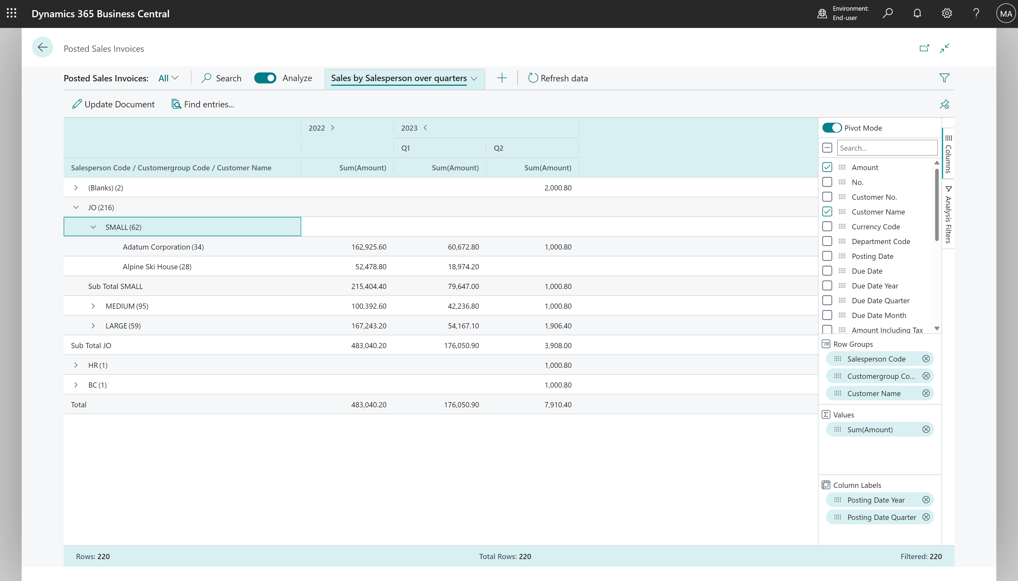
Salesperson bonus overview

Slide 25
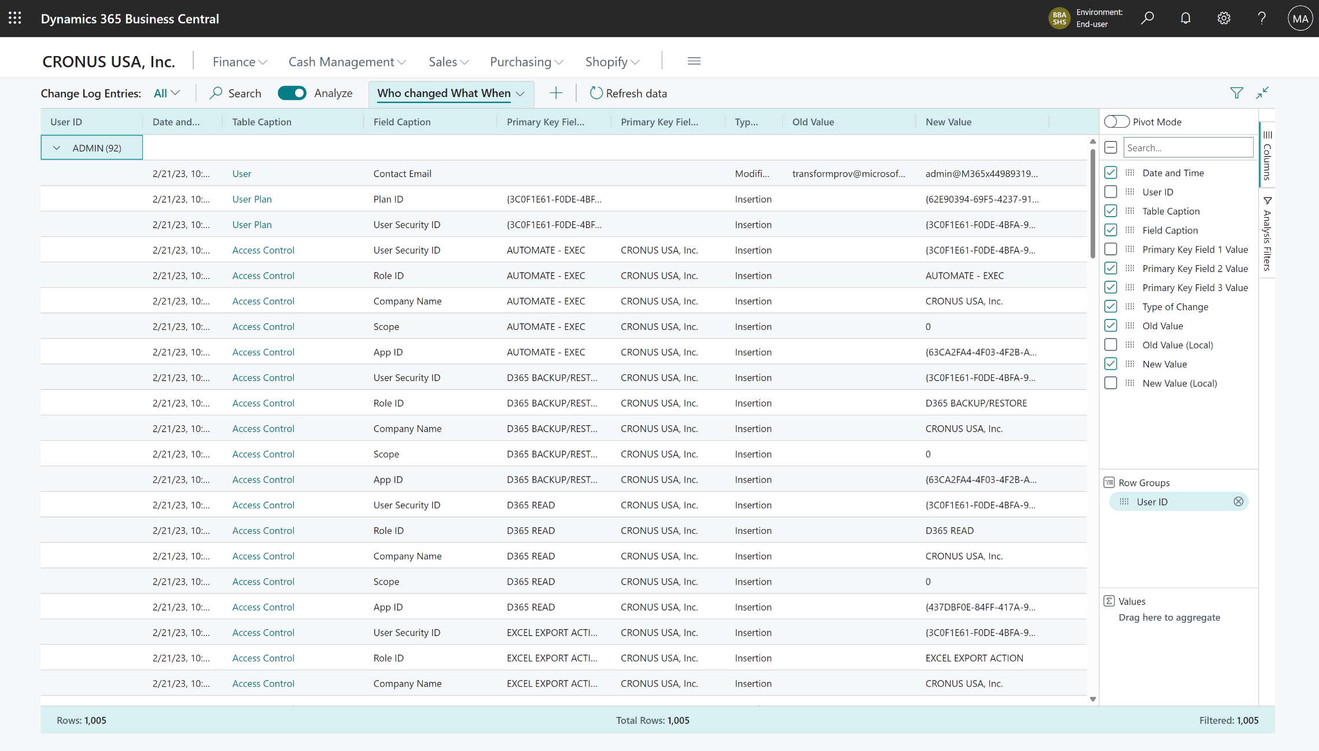
Compliance: Who changed What When

Slide 26
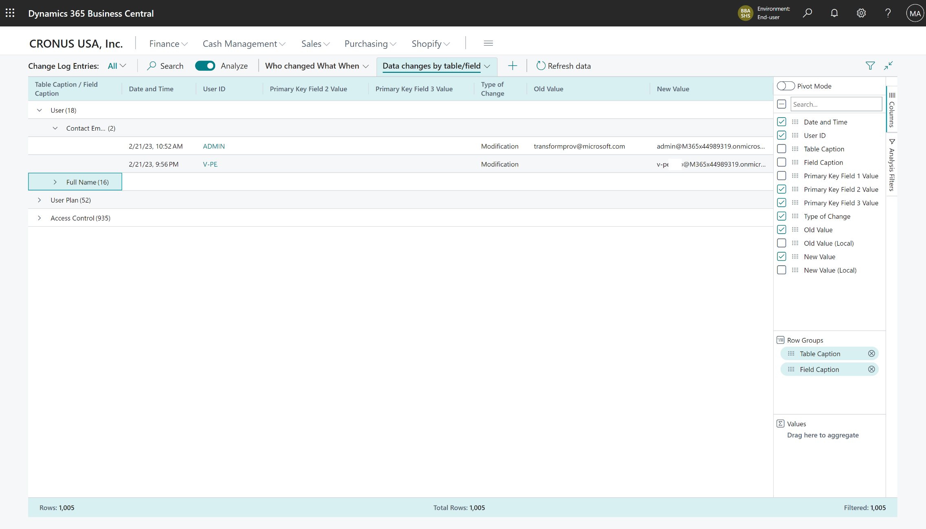
Compliance: Data Changes by table/field

Slide 27
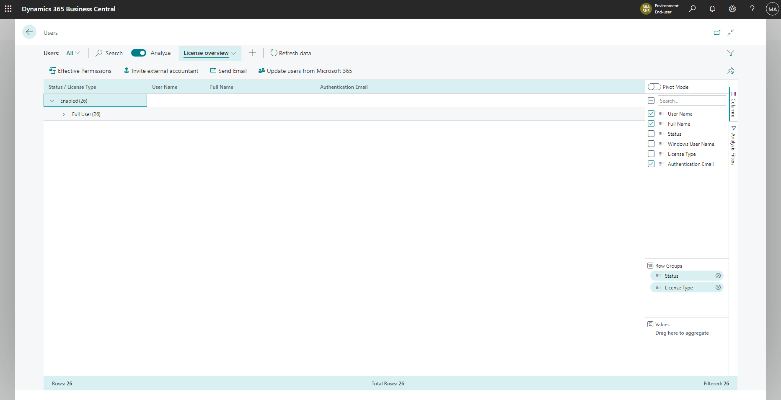
Compliance: License overview by user

Slide 28
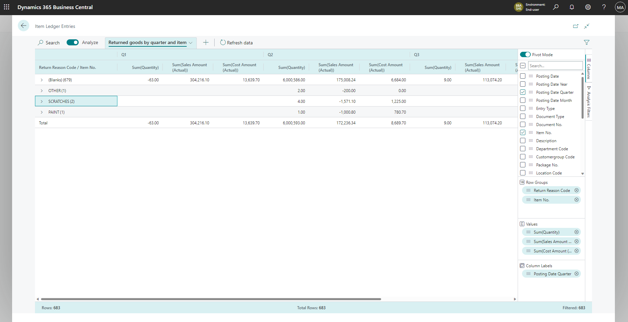
Inventory: Returned goods by Quarter and Item

Slide 29
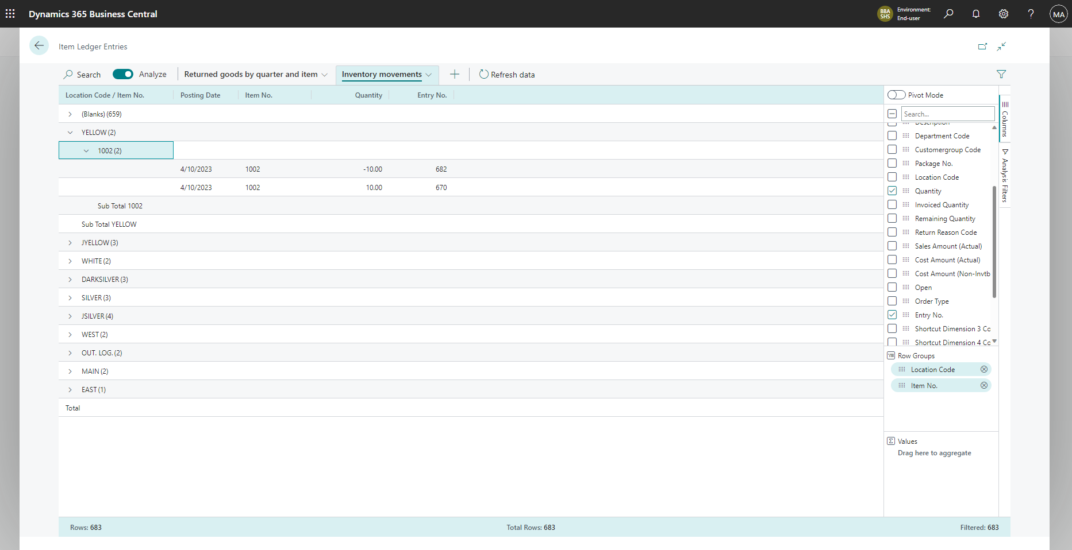
Inventory: Movements between locations

